Slide 1
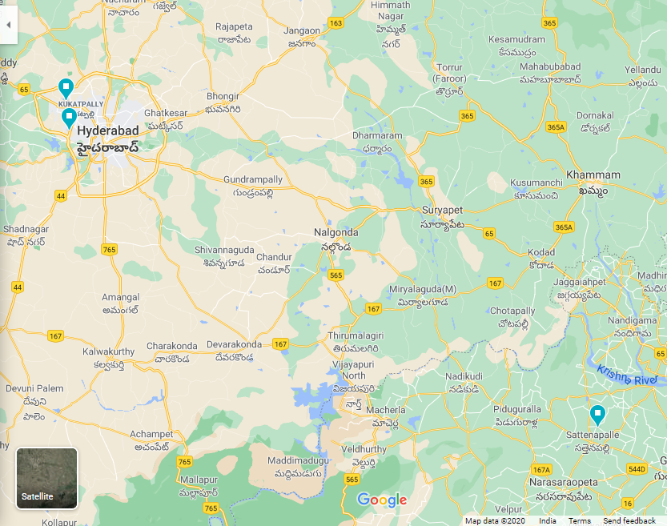
WAN Design for 1 Village, 2 Apartment Complex
Ram Pratap Bachina
20173098
Ravi Kumar Nandigam
20173101
Subhajit Sahu
2018801013
Abburu Village:
Ram Pratap Bachina
LAN Design
1000 houses
Park Pride Apartments:
Ravi Kumar Nandigam
LAN Design
15 flats
Golf View Apartments:
Subhajit Sahu
LAN Design
384 flats
Park Pride Apartments, Miyapur
Golf View Apartments, Gachibowli
Abburu Village, AP

Slide 2
Network Requirements
As part of National Village Growth Programme, the Government on India is encouraging people located in cities to directly contribute to one of the selected villages for upgradation in various respects (providing tax exemption). Residents at Park Pride Apartments & Golf View Apartments have chosen to contribute to Abburu Village.
Abburu Village Panchayat is to be connected with a file sharing network with both the apartment complexes in Hyderabad, which would be used for sharing various sensitive documents. Accordingly, encrypted WAN must be setup such that share folders can be accessed by all parties, without it being accessible in the public internet.
Both the Hyderabadis and village people already have a broadband connection, and desire a number of automation upgrades.
Setup Automated Metering Infrastructure (AMI) of each location for utilities such as electricity and piped gas (where available), using existing RF-DCU, GSM/GPRS, or WiFi based smart meters.
Install fire detection and alarm systems for alerting local people through loud sirens and contacting nearest fire department for extinguishing, with a 5-10 min window to prevent false alarms.
Provide a silent intrusion (burglar) detection system for alerting local security / gram panchayat, as well as contacting nearest police department, with again a 5-10 min window for false alarms.
Since Abburu village lies in seismic zone 3, a seismometer can be installed at village center in order to detect earthquakes and alert local people. Hyderabad lies in seismic zone 2.

Slide 3
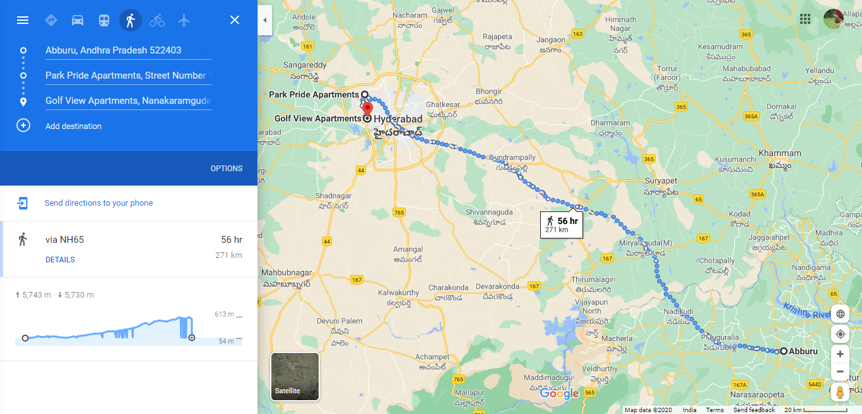

Slide 4
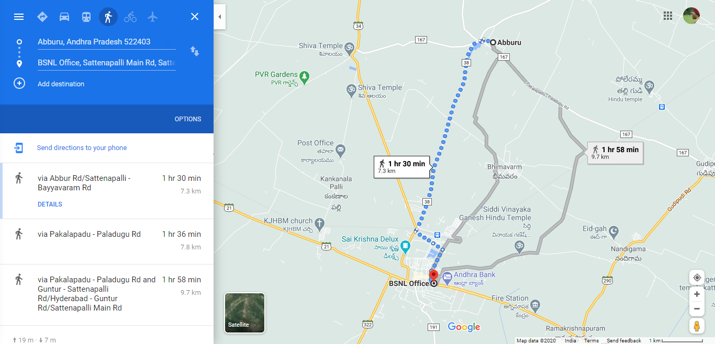
Abburu Village, Guntur district

Slide 5
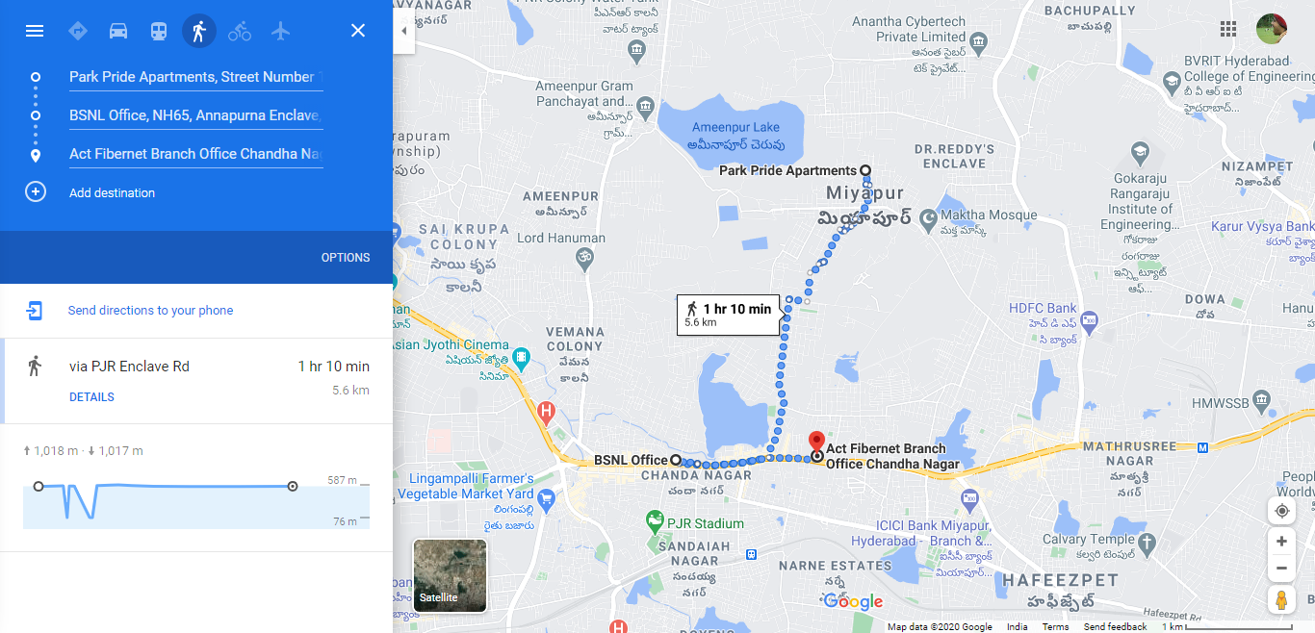
Park Pride Apartments, Miyapur

Slide 6
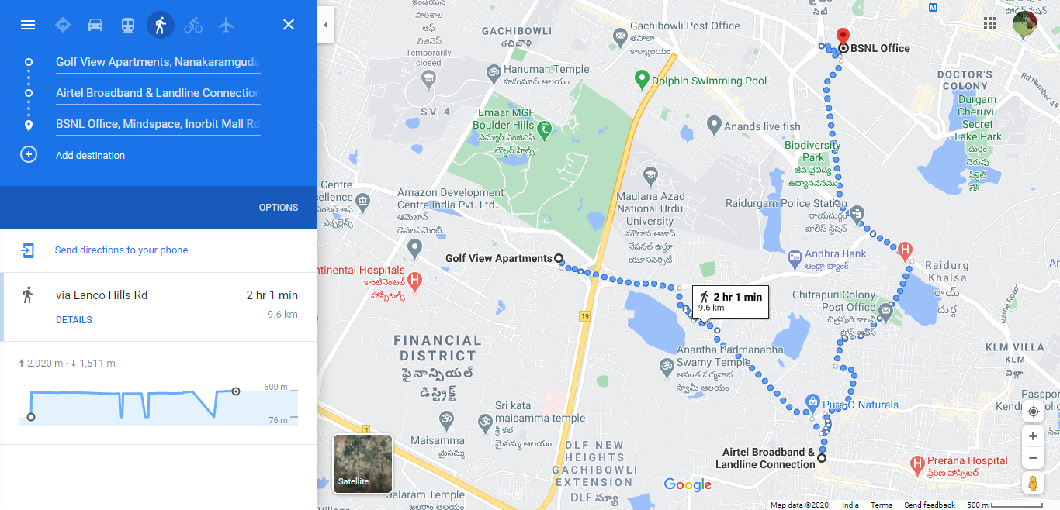
Golf View Apartments, Gachibowli

Slide 7
File Share WAN between locations
At Gram Panchayat, Abburu Village, a small WiFi network has been created through a Wireless Access Point WS1. This AP is connected to a VPN Router RO3.
Then VPN Router RO3 is then connected to the Central Core Switch SW3 which is connected to the ISP through optic fibre on its SFP ports.
This VPN Router acts as a VPN server and allows other VPN clients to join through the Internet, thus forming a Virtual WAN.
Devices connected through the VPN clients and well as devices connected through the Wireless AP here, can now share files among thesselves as if they belong to the same LAN.
At Ground floor Meeting room, Park Pride Apartments there is a very similar arrangement to that of Aburru village, except that the VPN Router RO3 is configured to act as a VPN client, and connect to the VPN server at Aburru village.
At Club house Meeting room, Golf View Apartments, the arrangement is exactly same as Park Pride Apartments.
In order to ensure good QoS, the port on which VPN Router RO3 is connected to Central Core Switch SW3 is assigned higher priority, than other data connections.
Highest priority is assigned to automated electricity metering network.
Sensitive documents can now be easily shared among the people, without having to resort to encrypted zip files in email.

Slide 8
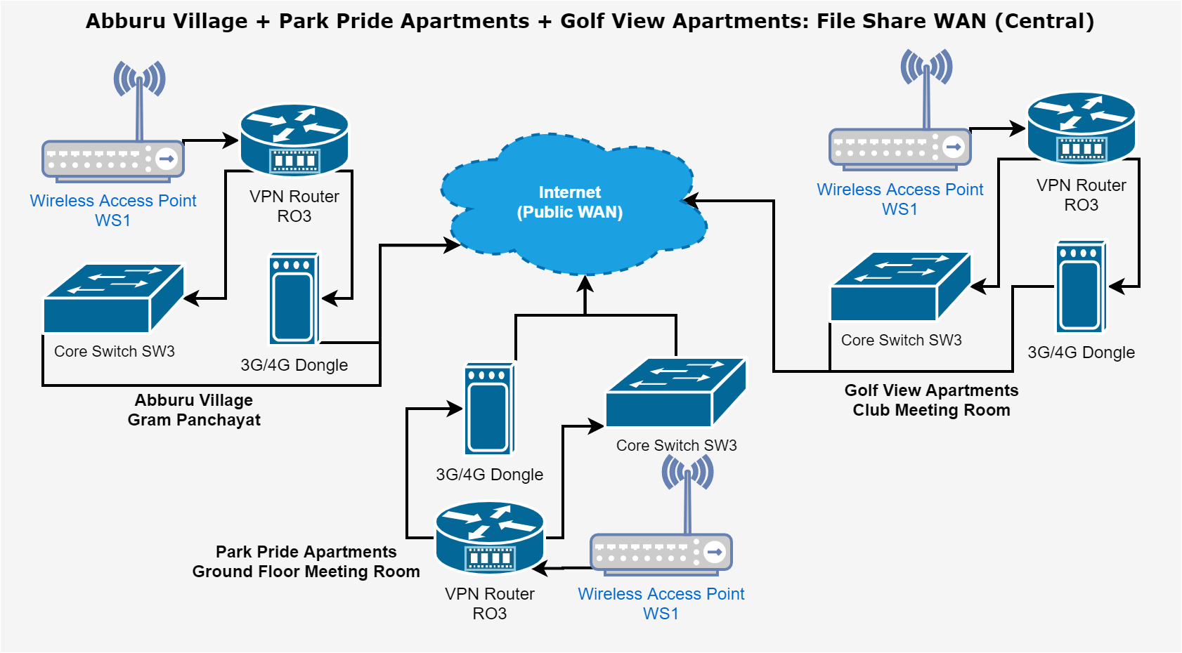

Slide 9
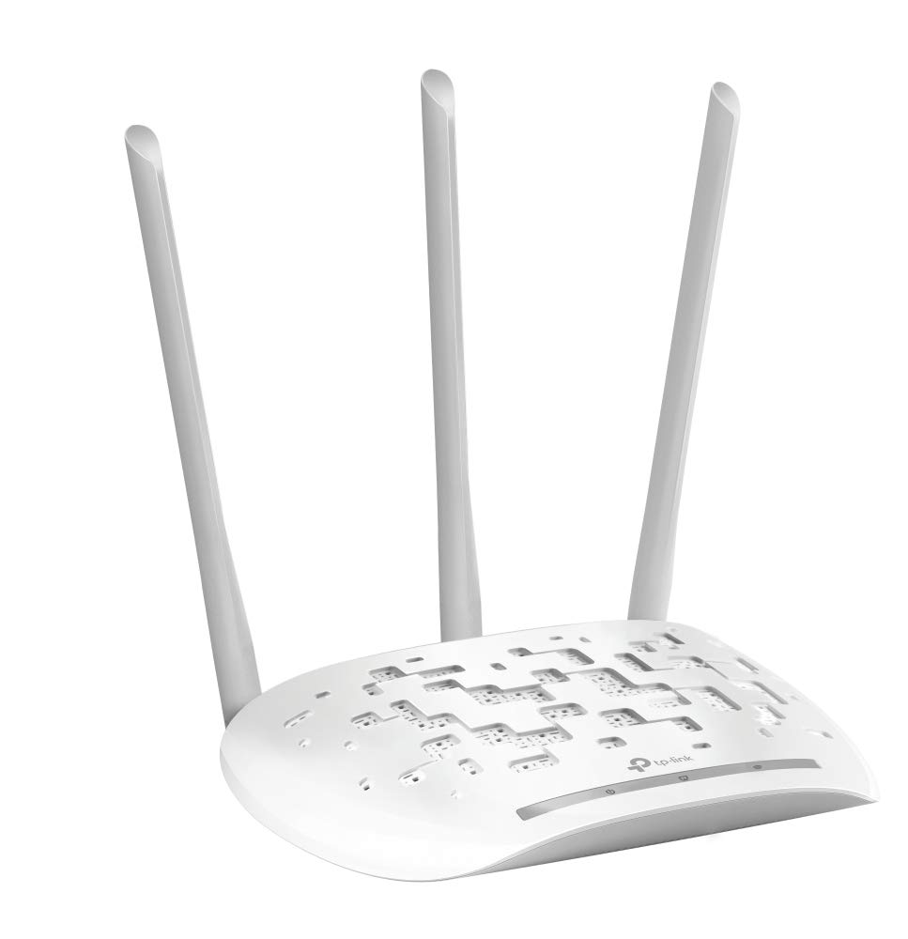
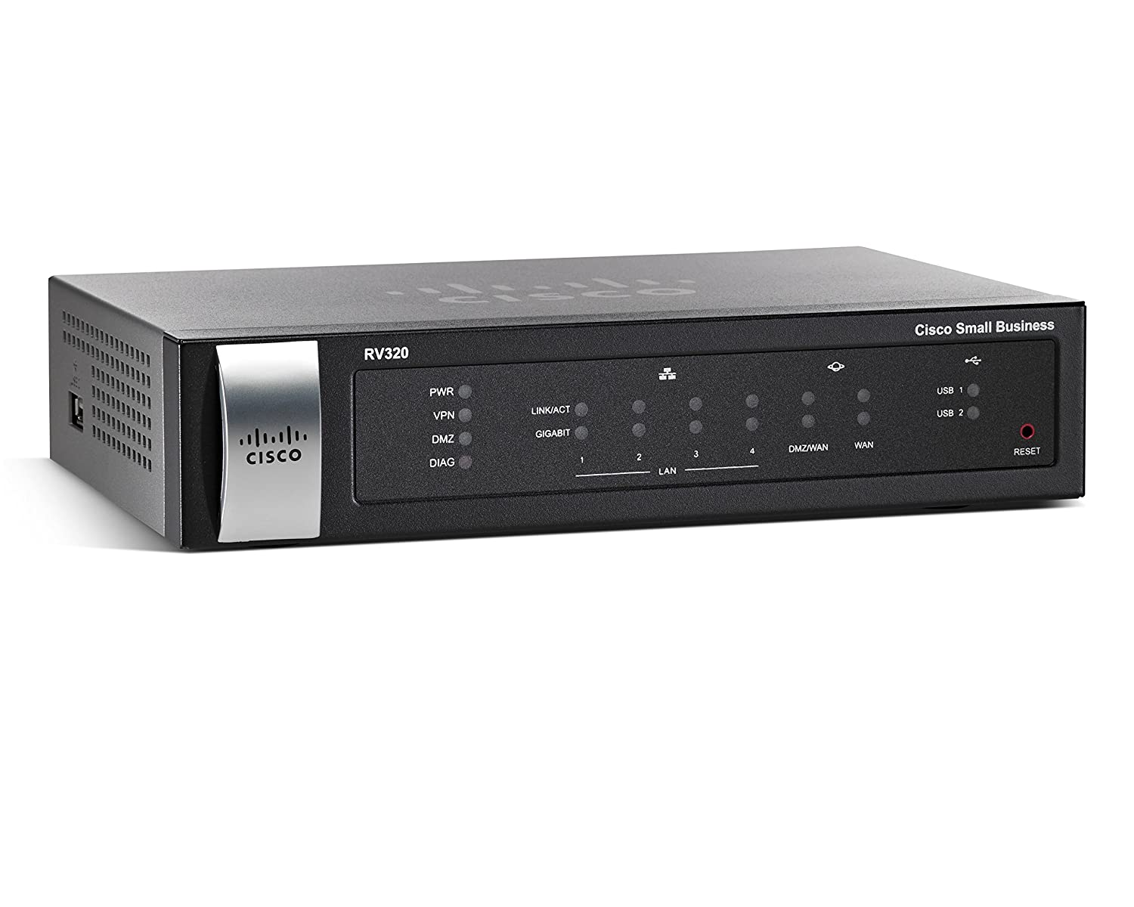
RO3 VPN Router
WS1 Wireless Access Point
₹ 19000 x 6
₹ 1700 x 3
Cisco RV320 VPN Router with Web Filter:
2 x GbE WAN for load balancing
2 x USB for 2G / 3G modem (if WAN fails)
SSL & site-site VPN
Stateful Packet Inspection (SPI) & HW Firewall
TP-Link TL-WA901N 450 Mbps Wireless N Access Point:
450 Mbps wireless N @ 2.4 GHz
Access Point, Range Extender, Multi SSID
Supports passive PoE (PoE injector included)
Upto 30 m (100 ft) range

Slide 10
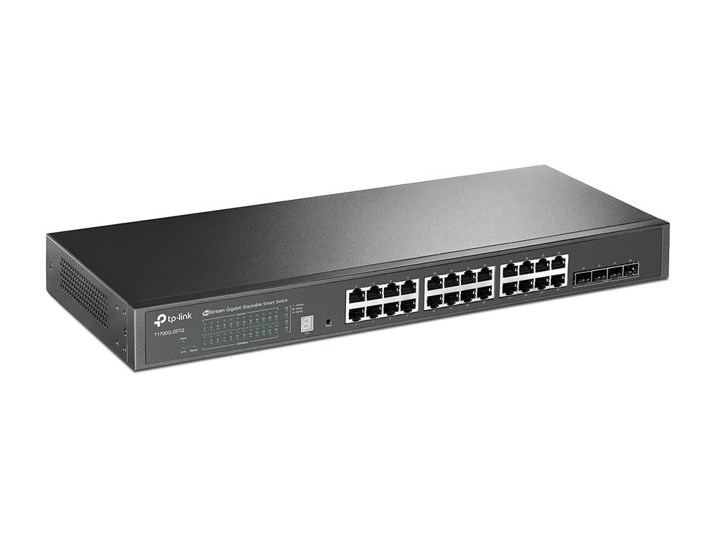
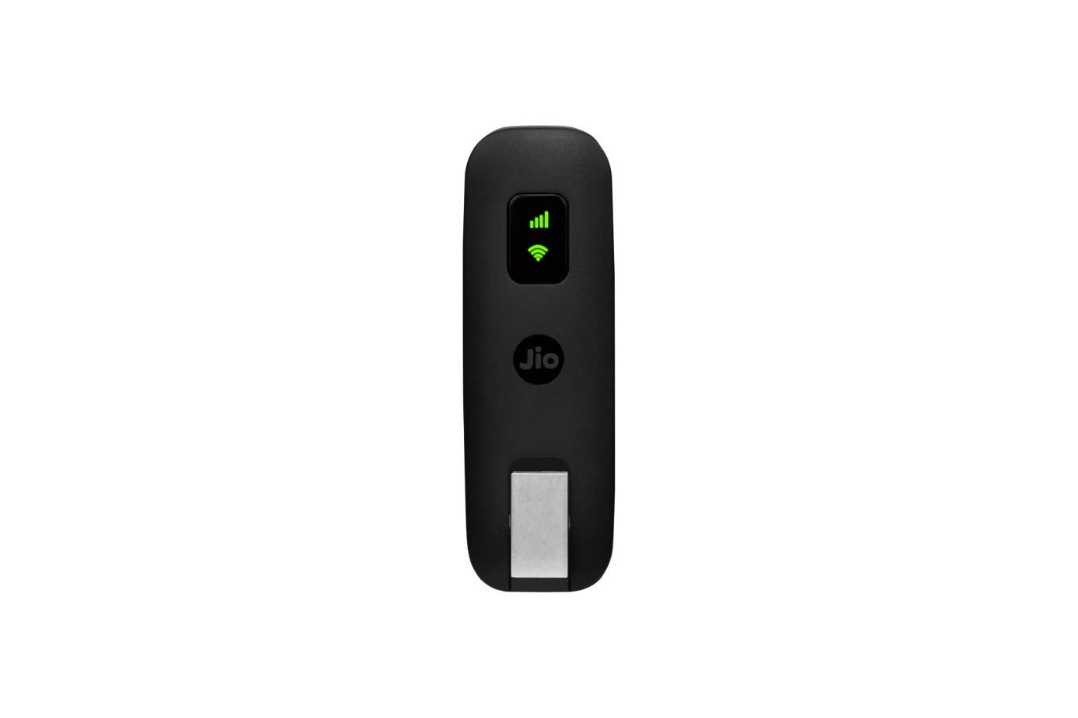
SW3 Central Core Switch
3G/4G Dongle
₹ 30000 x 7
₹ 2000 x 3
TP-Link JetStream T1700G-28TQ Smart Switch:
24 x GbE, 4 x 10GbE SFP+ slots
Stacking upto 6 units, 40 Gbps bidirectional BW
ACL, Port security, DoS defend, DHCP snooping
Web/CLI managed modes, SNMP, RMON
JioFi JDR740 Dongle 150 Mbps wireless 4G router:
4G speed: upto 150 Mbps download, 50 Mbps upload
Expandable memory capacity: 32 GB

Slide 11
Abburu Village: Metering System
Each house has a gas cylinder connection and thus has only an electricity meter.
The electricity meters communicate with either wired RS-485 or wireless RF mechanism with a Data Collection Unit (DCU) which is installed every street.
The DCU is connected to per-street managed switch on VLAN 110, which is reserved for metering purpose.
The per-street switch is connected to per-area Distribution switch, which is then connected to the central Core switch.
An Metering-cum-DHCP server is present in Gram Panchayat connected to the Core switch on VLAN 110. The DHCP server is used to assign IP address to all DCUs.
VPN Router RO3 can act as a VPN client and thus form a Virtual WAN with electricity board's network. A server on their network can now query all our metering devices.
The smart meters report to the power distribution company every 15 mins through the Metering server.
The metering server sends data to the power distribution company over HTTPS secure channel through GSM/GPRS modem.
This is done so because GSM/GPRS modems are cheaply available, are reliable, and are commonly used in most smart meters used in India (e.g. Genus).
There is also a backup GSM/GPRS modem that uses SIM from a different service provider in case the primary fails.
If the power distribution company provides a VPN server in order to connect all metering devices in a Virtual WAN, this can be achived through the VPN Router RO3.
The VPN Router connects with all metering devices on VLAN 110 and then connects to internet either through the Central Core Switch SW3 or a 3G/4G dongle connected to it USB port as backup.

Slide 12
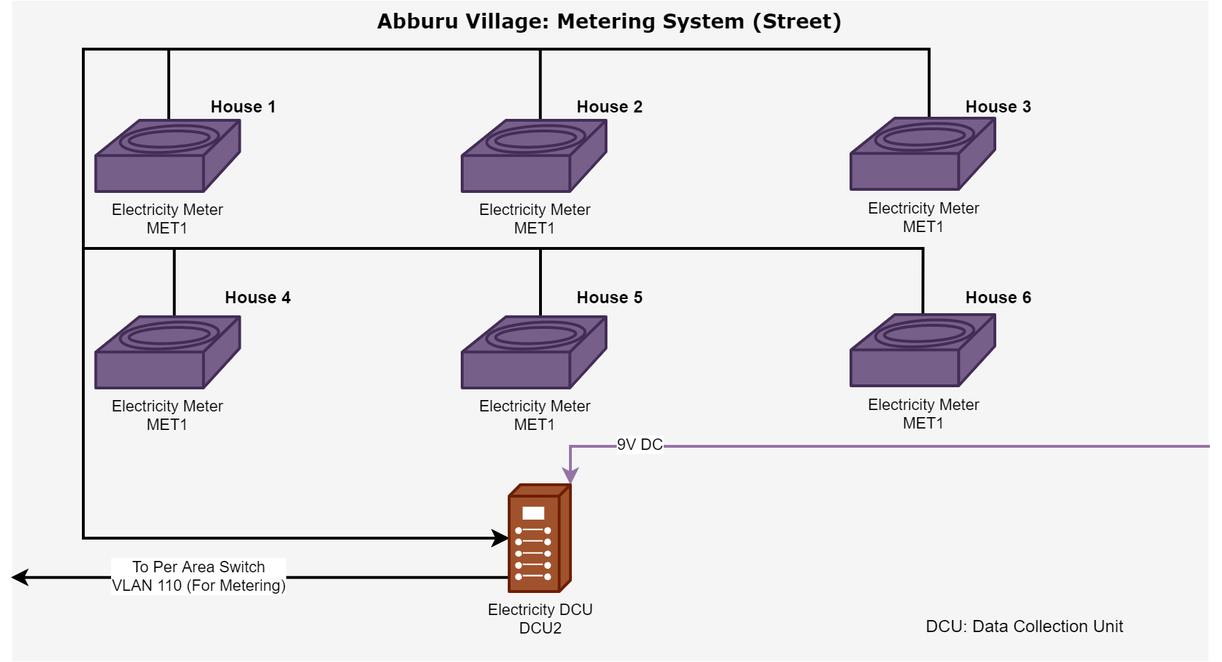

Slide 13
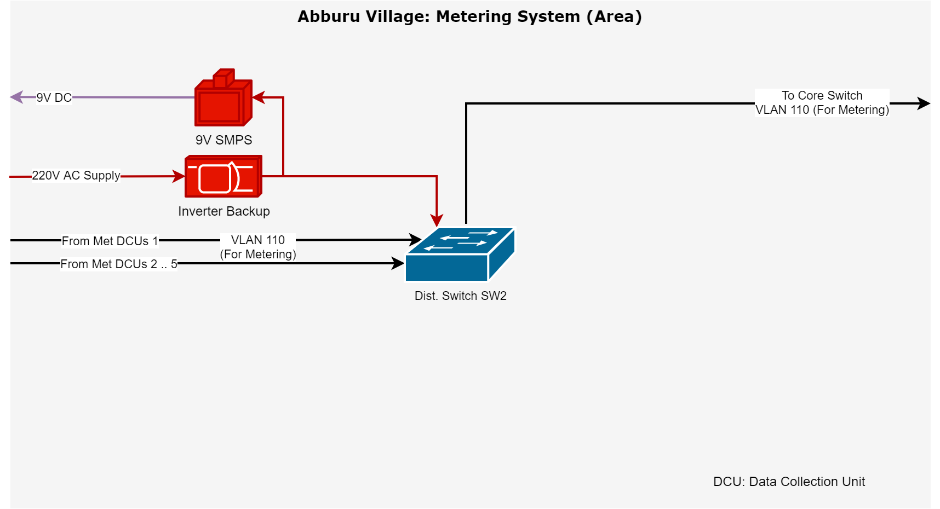

Slide 14
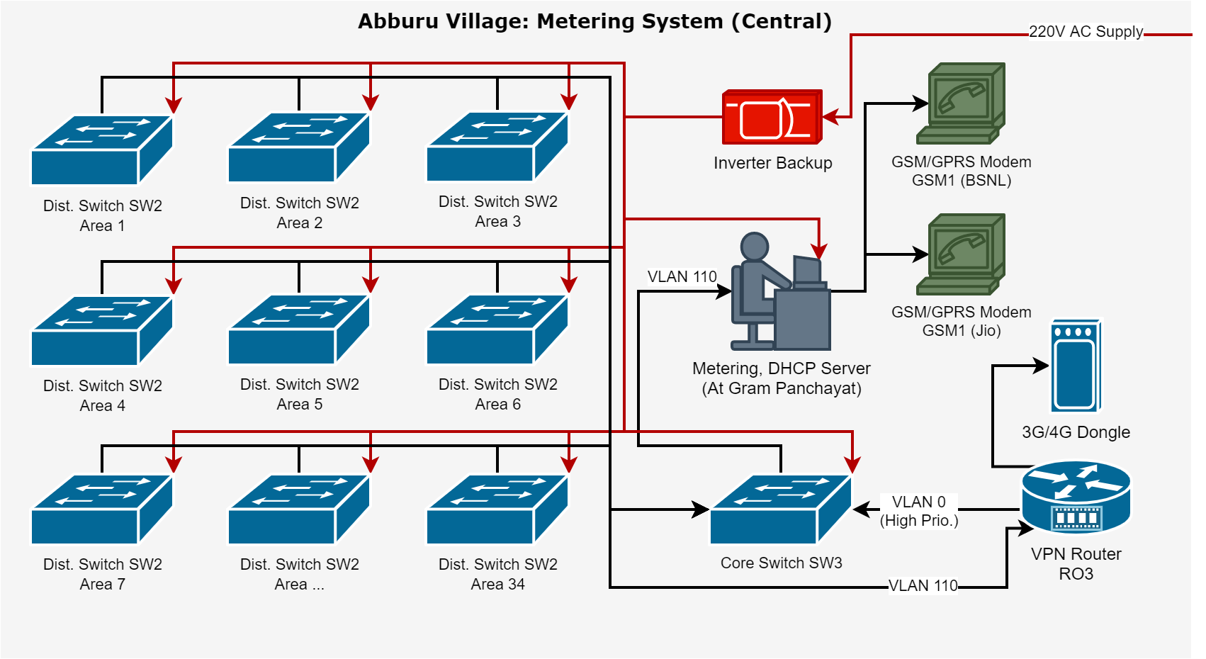

Slide 15
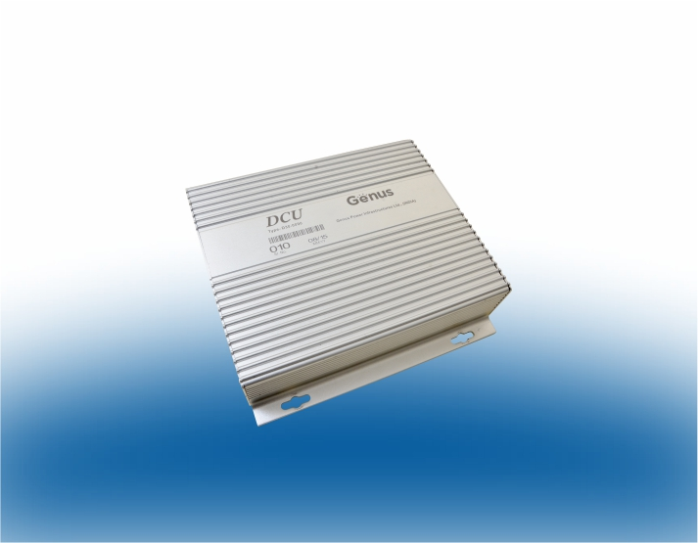
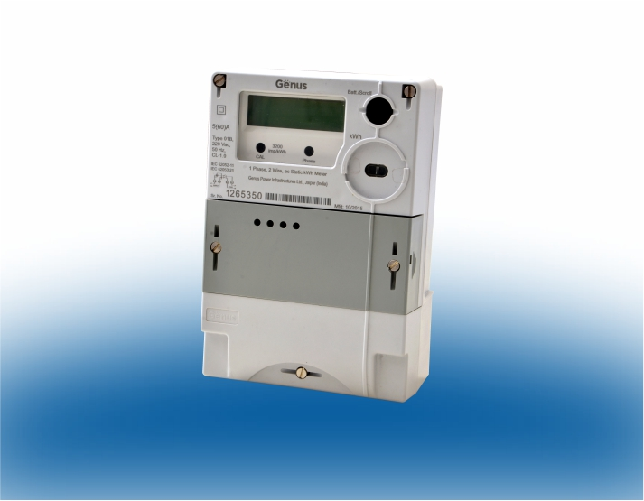
MET1 Electricity Meter
DCU2 Data Collector Unit
₹ ? x ?
₹ ? x ?
Saksham-125 Smart Residential Meter:
Single-phase AMI system
Load management, Multi Rate, Time of use, Anti-theft
Communicates w/ Head end sys. on req. or schedule
Integrated GSM/GPRS modem
Data Collector Unit (DCU):
Integrated LPRF & GSM/GPRS communication
LPRF communication on demand or schedule
GSM/GPRS communicates with Head End System (HES)

Slide 16
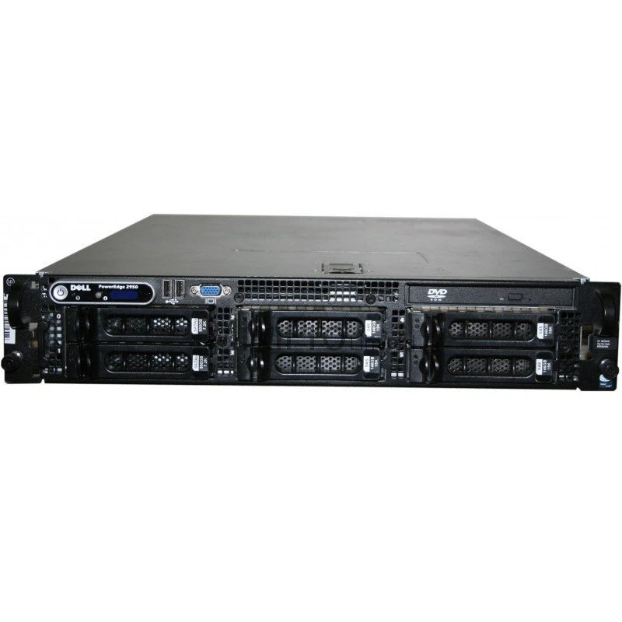
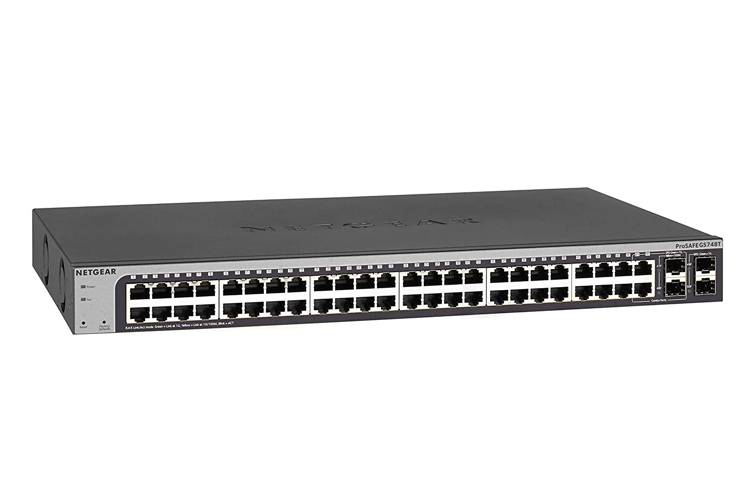
SW2 Dist. Switch
X, DHCP Server
₹ 26000 x 50
₹ 28000 x 6
Netgear GS748T-500INS Smart Managed Pro Switch:
48 x GbE, 4 x GbE SFP slots
VLAN, QoS, IGMP snooping, Link aggregation, ACL
Dell Power Edge 2950 III:
2U Rack mount
8 Core server
32 GB RAM
1 TB storage

Slide 17
Abburu Village: Fire Alarm + Earthquake System
We are using Signaling Line Circuit (SLC) based addressable smoke detectors and LPG/Propane Gas sensors. Each house is thus provided with a total of 2 sensors, and all 6 houses in a street are connected in a loop. Each street also has a Fire Alarm switch (manual) which can be used to manually trigger the fire alarm.
Each street's loop (total 5 streets/area) is then connected to a Fire Alarm Control Panel (FACP) system which is also connected to a central Fire Alarm Siren. Each street is also connected to its respective Siren from the FACP.
The FACP has a GSM/GPRS interface built-in through which it can be configured to send fire emergency events directly to nearby fire department at a certain delay (5-10 min to avoid false alarm).
In case there is a false alarm, the FACP's alarm can be shutdown with the delay time.
The FACP is also connected through ethernet port to the per-area Distribution switch.
All per-area Distribution switches are connected to the central Core switch (managed).
An Emergency-cum-DHCP server is present in Gram Panchayat connected to the Core switch on VLAN 100. The DHCP server is used to assign IP address to all DCUs.
In case a Fire alarm is triggered, the Emergency server alerts the Panchayat, rings the central siren, and indicates the house number of the source.
There is also a backup GSM/GPRS module connected so that in case the one directly connected to FACP fails, the Emergency server can send the message on its behalf.
Since Abbru lies in seismic zone 3, a seismometer is installed at Gram Panchayat, and NDRF can be contacted in case a earthquake is detected (unless marked false-positive in 5-10 min).

Slide 18
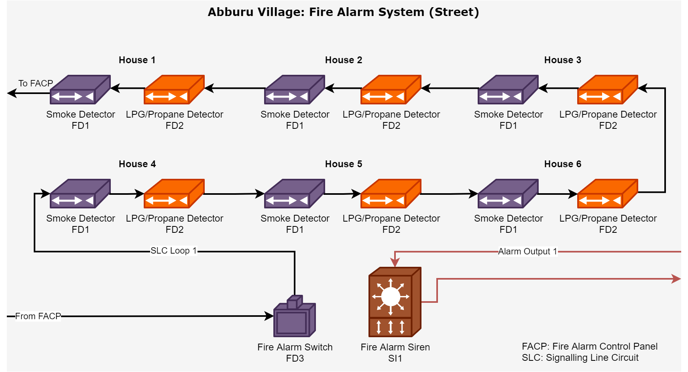

Slide 19
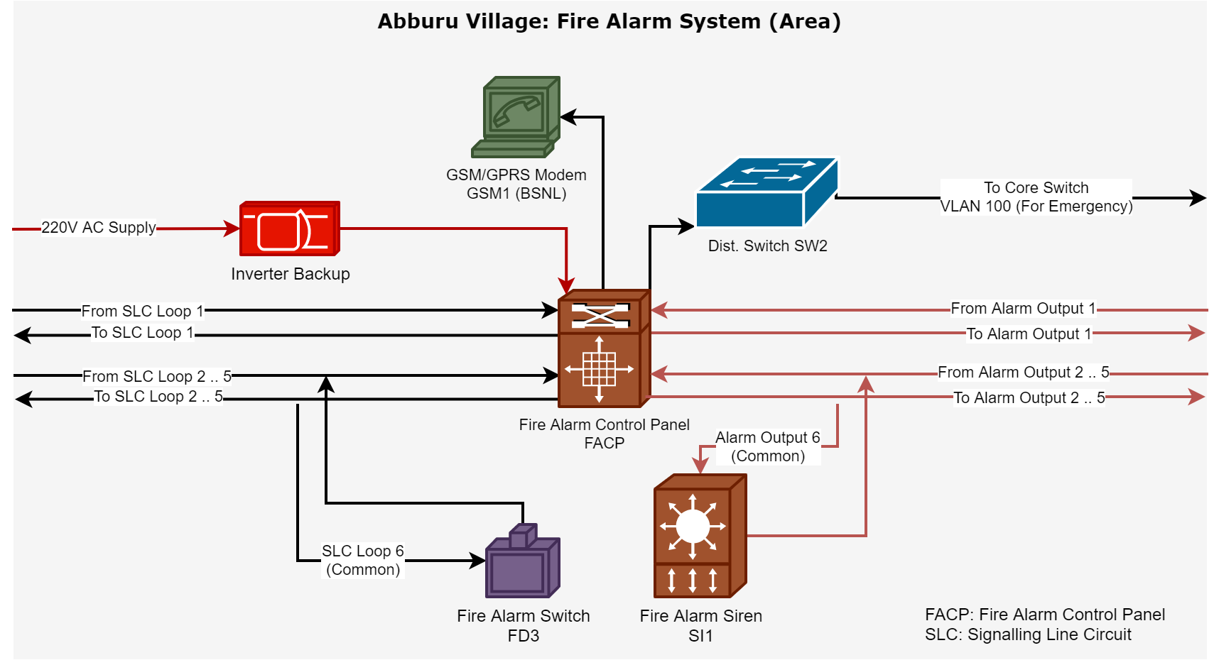

Slide 20
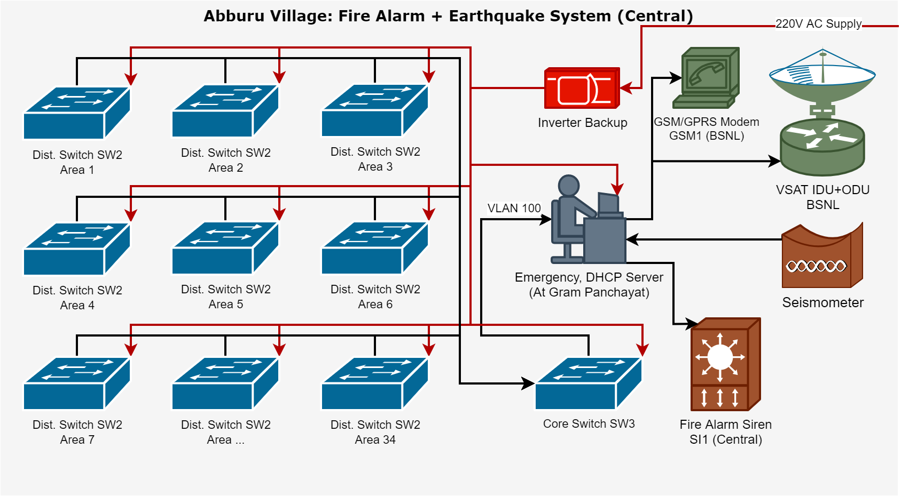

Slide 21
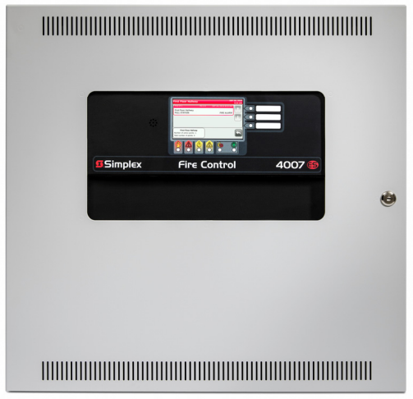
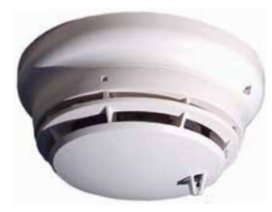
FD1 Smoke Detector
FACP Fire Alarm Ctrl. Panel
₹ ? x ?
₹ ? x ?
4098-9754EA TrueAlarm Photoelectric & Heat Multi-Sensor Detector:
Analog photoelectric smoke & heat sensing
Digital transmission of analog data
Addressing dipswitch in permanently mounted base
Automatic environmental compensation
Fixed & Rate-of-rise heat detection
Simplex 4007ES Fire Control Panel:
Provides built-in short circuit isolation for monitoring and control of TrueAlarm analog sensors and IDNet communications monitoring and control devices
Standard panel SLC provides up to 100 addressable points
Battery backup charging of up to 33 Ah

Slide 22
Abburu Village: Security System
We are using simple PIR sensors, that are able to detect motion as our security element. The sensor triggers an event when it detects motion, and this is sent to a Data Collection Unit (DCU).
The sensors have a trigger enable switch which can be turned on and off. Normally, when people are staying in the house, the switch is turned off.
When the members are about to leave their house empty, they turn on the switch, which enables the PIR sensor. From now on, if any burglar enters the apartment, it can be detected by the PIR sensor. When residents come back, they remotely turn off the sensor.
The DCU is connected with ethernet cable to a hierarchy of managed routers. Any motion detect events are sent over IP packets to an Emergency server located with the Security.
The DCU connected port is configured as VLAN 100, which is reserved for all emergency devices of the network.
An Emergency-cum-DHCP server is present in Gram Panchayat connected to the Core switch on VLAN 100. The DHCP server is used to assign IP address to all DCUs.
In case an PIR sensor trigger event is detected, the Emergency server alerts the Panchayat, indicating the house number of the source.
If it is not marked as false alarm within 5-10 mins, a message is sent to nearest police department through GSM/GPRS modem (with a backup in case).

Slide 23
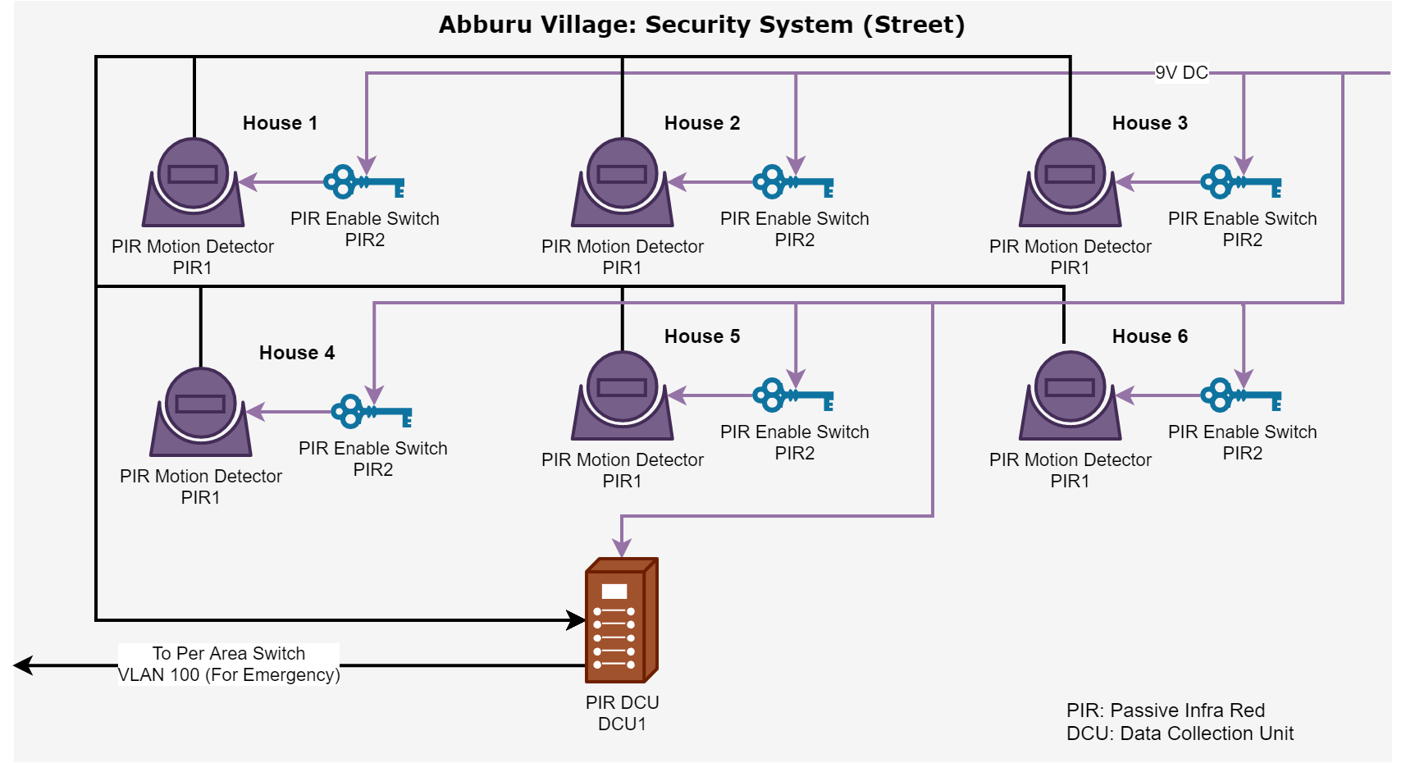

Slide 24
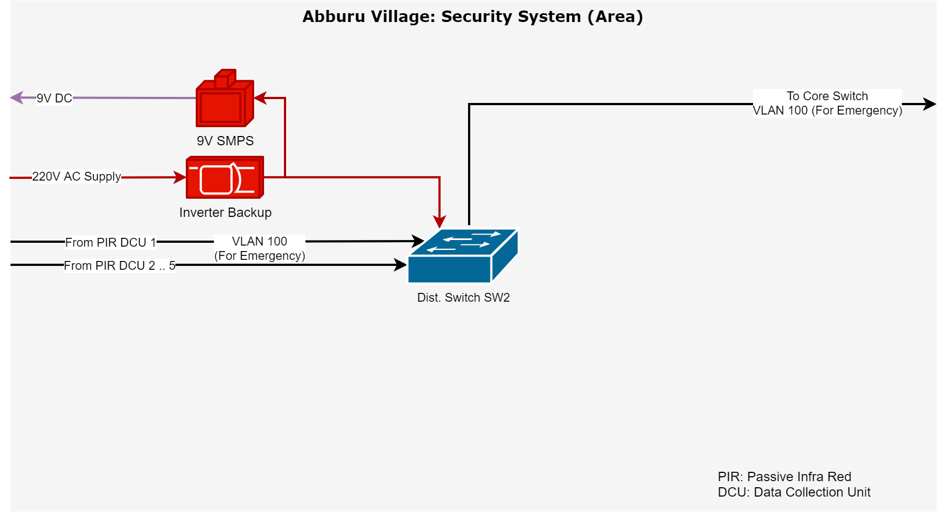

Slide 25
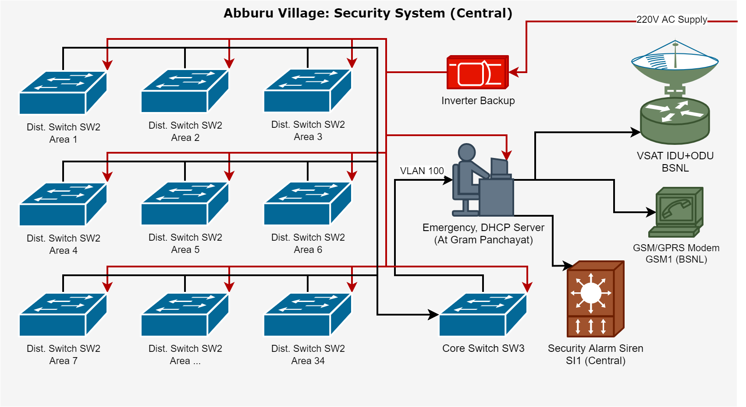

Slide 26
Park Pride Apartments: Metering System
Each apartment has a piped gas connection and thus has a gas meter as well as an electricity meter. The gas meter operates with 9V DC power provided by an SMPS installed in first floor.
The electricity and gas meters communicate with either wired RS-485 or wireless RF mechanism with a Data Collection Unit (DCU) which is installed every floor.
The DCU is connected to per-floor managed switch on VLAN 110, which is reserved for metering purpose. The per-floor switch is connected to the central Core switch.
An Metering-cum-DHCP server is present in 1st floor connected to the Core switch on VLAN 110. The DHCP server is used to assign IP address to all DCUs.
VPN Router RO3 can act as a VPN client and thus form a Virtual WAN with electricity board's network. A server on their network can now query all our metering devices.
The smart meters report to the power distribution company every 15 mins through the Metering server.
The metering server sends data to the power distribution company over HTTPS secure channel through GSM/GPRS modem.
This is done so because GSM/GPRS modems are cheaply available, are reliable, and are commonly used in most smart meters used in India (e.g. Genus).
There is also a backup GSM/GPRS modem that uses SIM from a different service provider in case the primary fails.
If the power distribution company provides a VPN server in order to connect all metering devices in a Virtual WAN, this can be achived through the VPN Router RO3.
The VPN Router connects with all metering devices on VLAN 110 and then connects to internet either through the Central Core Switch SW3 or a 3G/4G dongle connected to it USB port as backup.

Slide 27
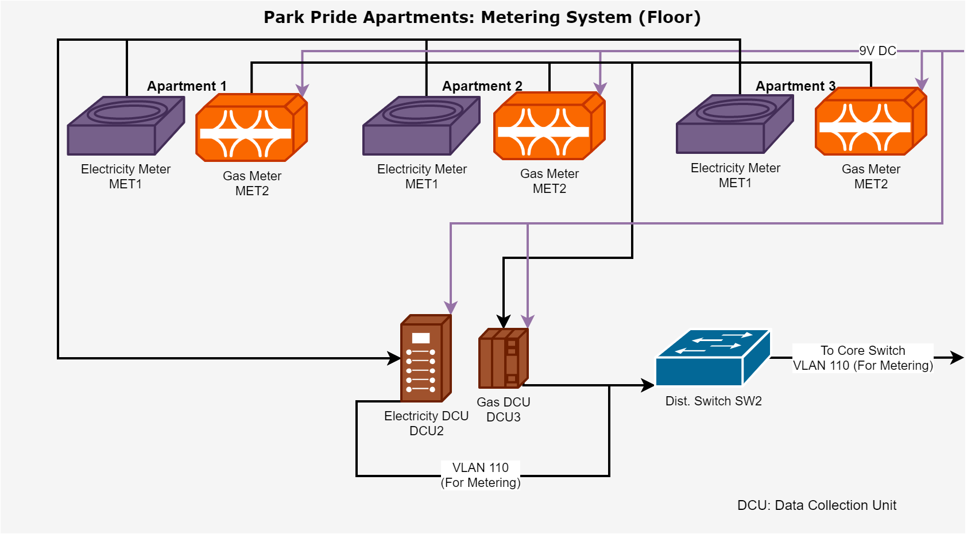

Slide 28
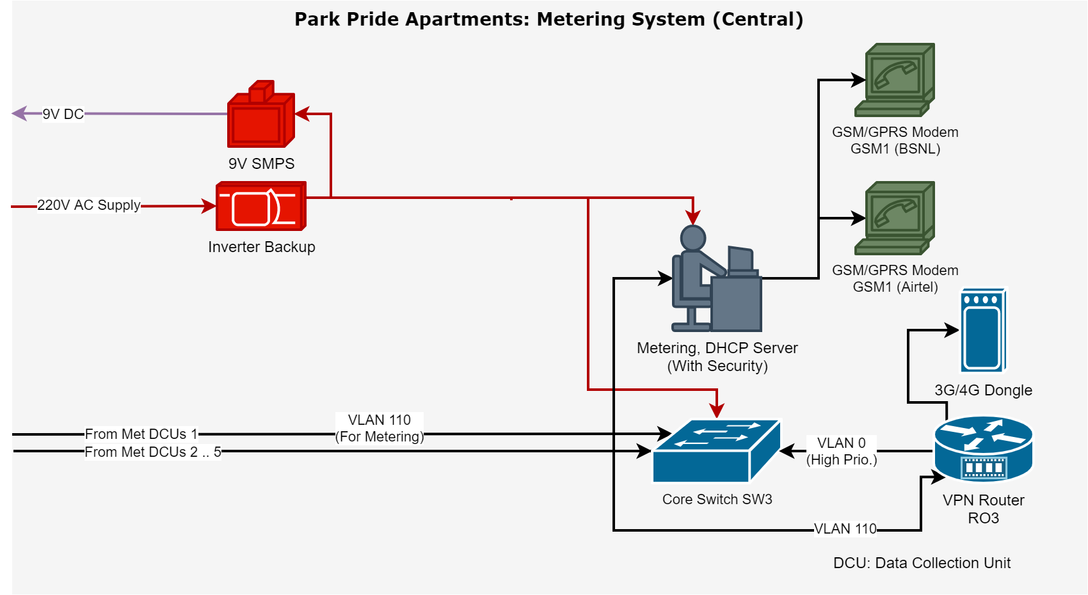

Slide 29
Park Pride Apartments: Fire Alarm System
We are using Signaling Line Circuit (SLC) based addressable smoke detectors and LPG/Propane Gas sensors. Each apartment is thus provided with a total of 2 sensors, and all 3 apartments in a floor are connected in a loop. Each floor also has a Fire Alarm switch (manual) which can be used to manually trigger the fire alarm.
Each floor's loop (total 5 floors) is then connected to a Fire Alarm Control Panel (FACP) system which is also connected to a central Fire Alarm Siren. Each floor is also connected to its respective Siren from the FACP.
The FACP has a GSM/GPRS interface built-in through which it can be configured to send fire emergency events directly to nearby fire department at a certain delay (5-10 min to avoid false alarm).
In case there is a false alarm, the FACP's alarm can be shutdown with the delay time.
The FACP is also connected through ethernet port to the central Core switch (managed).
An Emergency-cum-DHCP server is present in 1st floor connected to the Core switch on VLAN 100. The DHCP server is used to assign IP address to all DCUs.
In case a Fire alarm is triggered, the Emergency server alerts the security, rings the central siren, and indicates the apartment number of the source.
There is also a backup GSM/GPRS module connected so that in case the one directly connected to FACP fails, the Emergency server can send the message on its behalf.

Slide 30
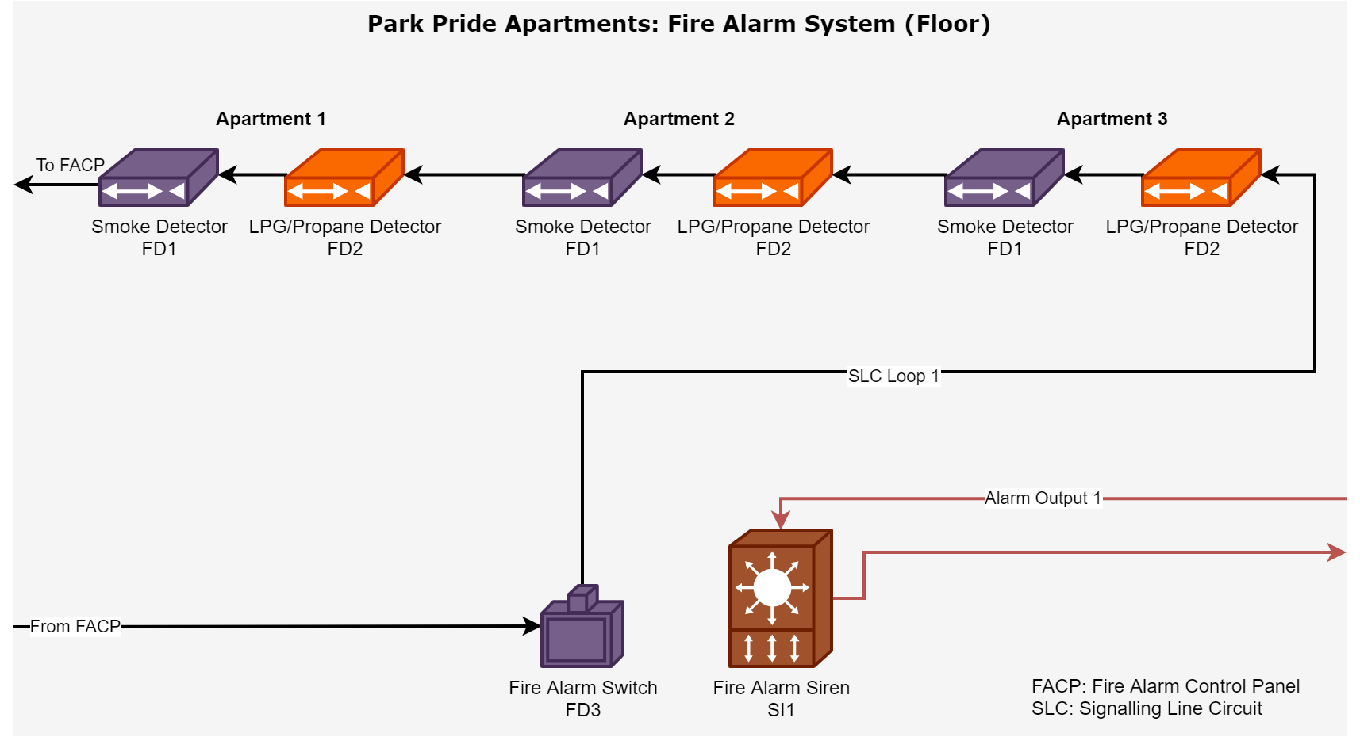

Slide 31
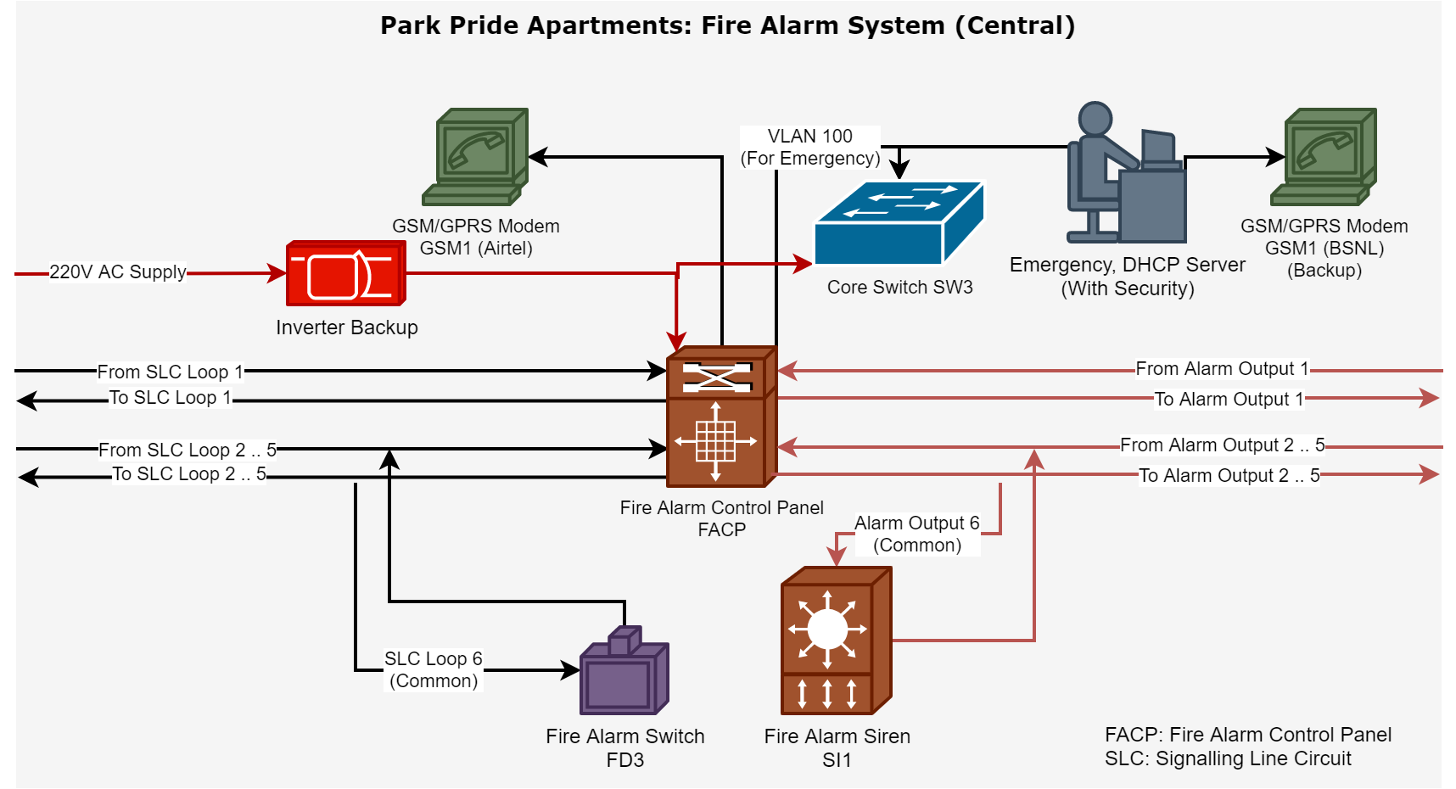

Slide 32
Park Pride Apartments: Security System
We are using simple PIR sensors, that are able to detect motion as our security element. The sensor triggers an event when it detects motion, and this is sent to a Data Collection Unit (DCU).
The sensors have a trigger enable switch which can be turned on and off. Normally, when people are staying in the flat, the switch is turned off.
When the members are about to leave their apartment empty, they turn on the switch, which enables the PIR sensor. From now on, if any burglar enters the apartment, it can be detected by the PIR sensor. When residents come back, they remotely turn off the sensor.
The DCU is connected with ethernet cable to a managed router on the floor. Any motion detect events are sent over IP packets to an Emergency server located with the Security.
The DCU connected port is configured as VLAN 100, which is reserved for all emergency devices of the network.
The managed switch is then connected with Cat 6 cable to the central Core switch at 1st floor.
An Emergency-cum-DHCP server is present in 1st floor connected to the Core switch on VLAN 100. The DHCP server is used to assign IP address to all DCUs.
In case an PIR sensor trigger event is detected, the Emergency server alerts the security, indicating the apartment number of the source.
If it is not marked as false alarm within 5-10 mins, a message is sent to nearest police department through GSM/GPRS modem (with a backup in case).

Slide 33
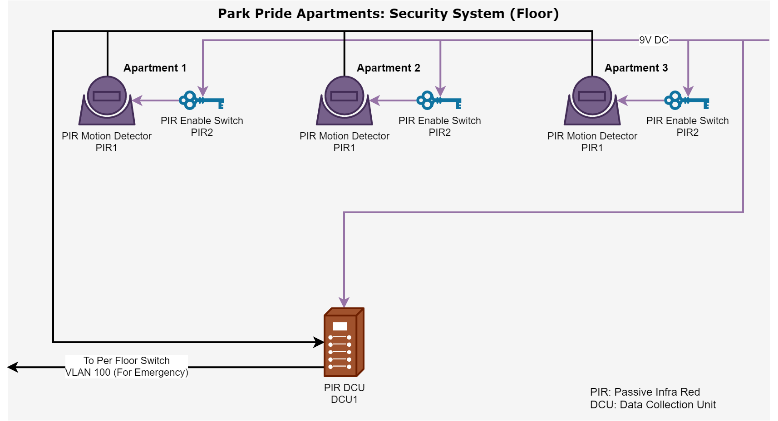

Slide 34
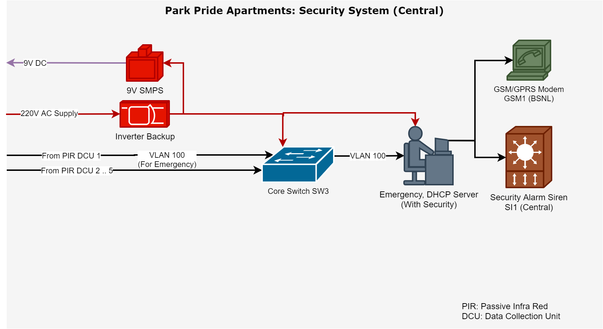

Slide 35
Golf View Apartments: Metering System
Each apartment has a piped gas connection and thus has a gas meter as well as an electricity meter. The gas meter operates with 9V DC power provided by an SMPS installed in first floor.
The electricity and gas meters communicate with either wired RS-485 or wireless RF mechanism with a Data Collection Unit (DCU) which is installed every floor.
The DCU is connected to per-floor managed switch on VLAN 110, which is reserved for metering purpose. The per-floor switch is connected to per-Block Distribution switch, which is then connected to the central Core switch.
An Metering-cum-DHCP server is present in A-Block connected to the Core switch on VLAN 110. The DHCP server is used to assign IP address to all DCUs.
VPN Router RO3 can act as a VPN client and thus form a Virtual WAN with electricity board's network. A server on their network can now query all our metering devices.
The smart meters report to the power distribution company every 15 mins through the Metering server.
The metering server sends data to the power distribution company over HTTPS secure channel through GSM/GPRS modem.
This is done so because GSM/GPRS modems are cheaply available, are reliable, and are commonly used in most smart meters used in India (e.g. Genus).
There is also a backup GSM/GPRS modem that uses SIM from a different service provider in case the primary fails.
If the power distribution company provides a VPN server in order to connect all metering devices in a Virtual WAN, this can be achived through the VPN Router RO3.
The VPN Router connects with all metering devices on VLAN 110 and then connects to internet either through the Central Core Switch SW3 or a 3G/4G dongle connected to it USB port as backup.

Slide 36
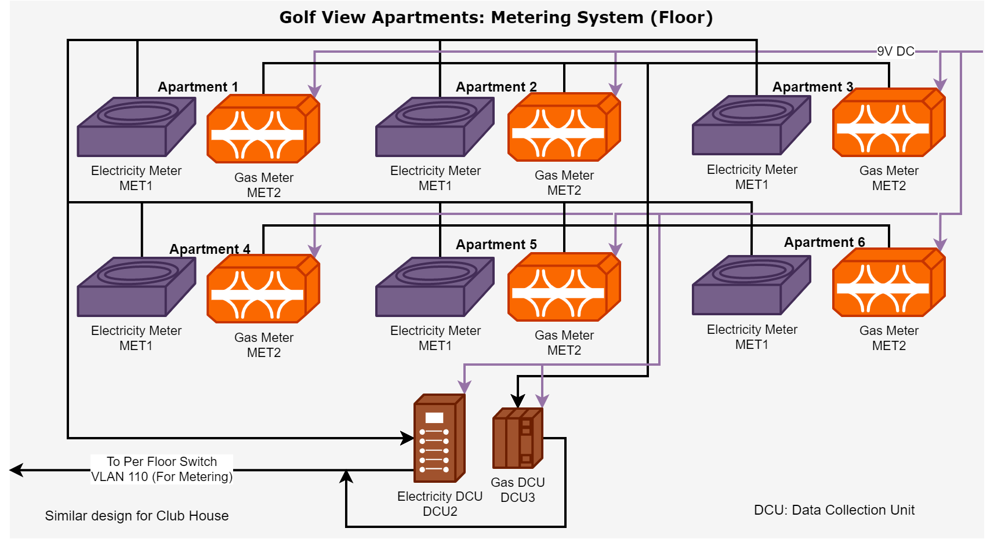

Slide 37
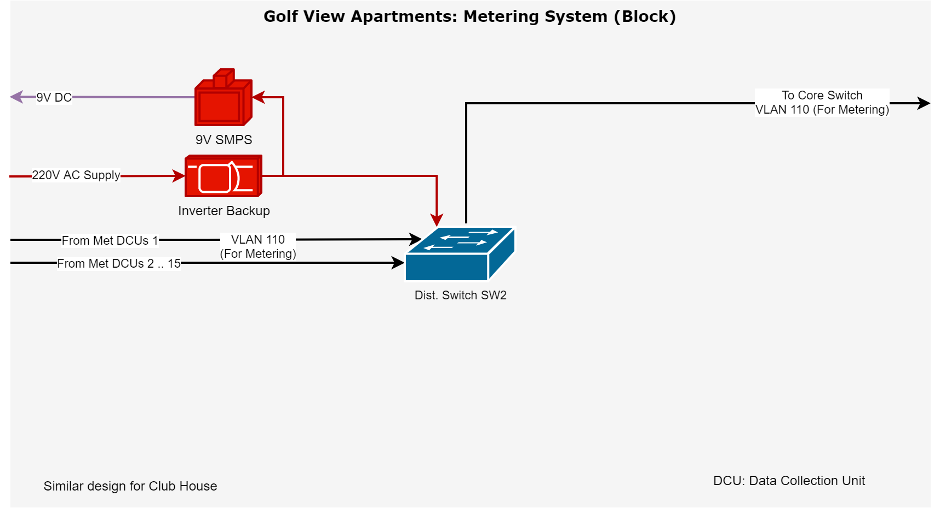

Slide 38
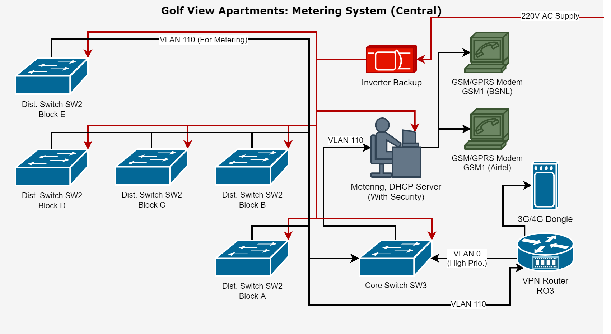

Slide 39
Golf View Apartments: Fire Alarm System
We are using Signaling Line Circuit (SLC) based addressable smoke detectors and LPG/Propane Gas sensors. Each apartment is thus provided with a total of 2 sensors, and all 6 apartments in a floor are connected in a loop. Each floor also has a Fire Alarm switch (manual) which can be used to manually trigger the fire alarm.
Each floor's loop (total 15 floors/block) is then connected to a Fire Alarm Control Panel (FACP) system which is also connected to a central Fire Alarm Siren. Each floor is also connected to its respective Siren from the FACP.
The FACP has a GSM/GPRS interface built-in through which it can be configured to send fire emergency events directly to nearby fire department at a certain delay (5-10 min to avoid false alarm).
In case there is a false alarm, the FACP's alarm can be shutdown with the delay time.
The FACP is also connected through ethernet port to the per-Block Distribution switch.
All per-Block Distribution switches are connected to the central Core switch (managed).
An Emergency-cum-DHCP server is present in A-Block connected to the Core switch on VLAN 100. The DHCP server is used to assign IP address to all DCUs.
In case a Fire alarm is triggered, the Emergency server alerts the security, rings the central siren, and indicates the apartment number of the source.
There is also a backup GSM/GPRS module connected so that in case the one directly connected to FACP fails, the Emergency server can send the message on its behalf.

Slide 40
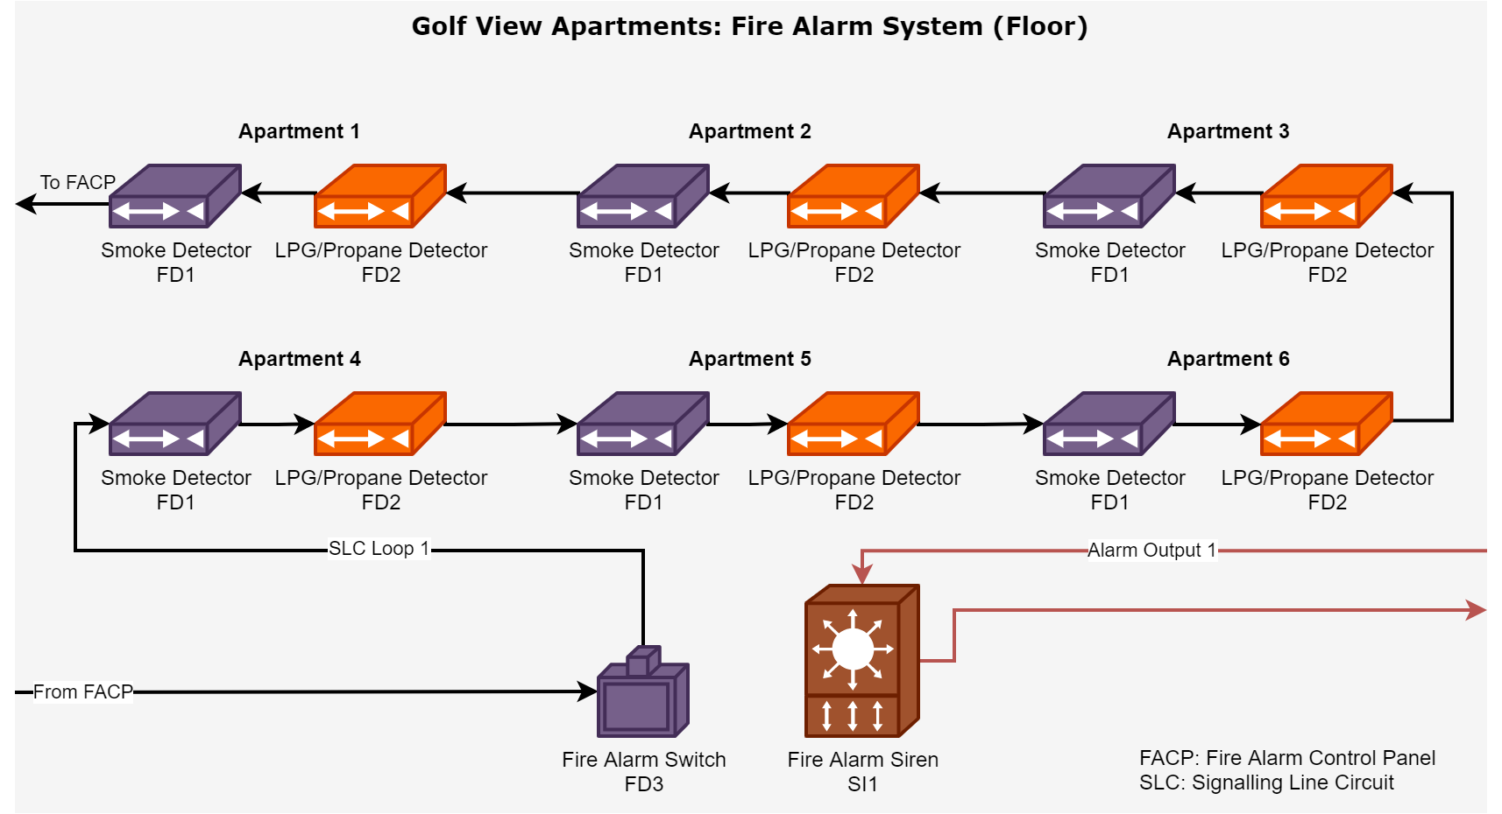

Slide 41


Slide 42
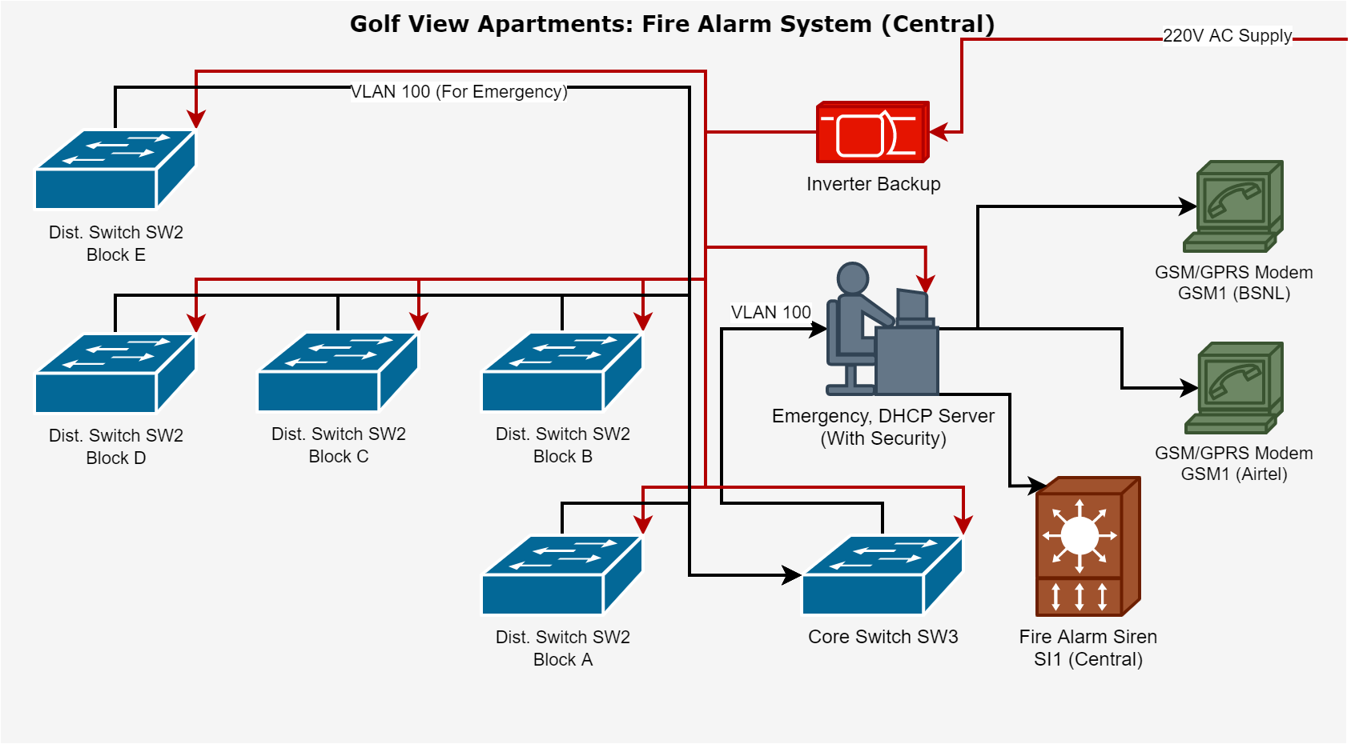

Slide 43
Golf View Apartments: Security System
We are using simple PIR sensors, that are able to detect motion as our security element. The sensor triggers an event when it detects motion, and this is sent to a Data Collection Unit (DCU).
The sensors have a trigger enable switch which can be turned on and off. Normally, when people are staying in the flat, the switch is turned off.
When the members are about to leave their apartment empty, they turn on the switch, which enables the PIR sensor. From now on, if any burglar enters the apartment, it can be detected by the PIR sensor. When residents come back, they remotely turn off the sensor.
The DCU is connected with ethernet cable to a managed router on the floor. Any motion detect events are sent over IP packets to an Emergency server located with the Security.
The DCU connected port is configured as VLAN 100, which is reserved for all emergency devices of the network.
The managed switch is then connected with Cat 6 cable to the per-Block managed Distribution switch at 1st floor.
All per-Block Distribution switches are connected to the central Core switch (managed).
An Emergency-cum-DHCP server is present in A-Block connected to the Core switch on VLAN 100. The DHCP server is used to assign IP address to all DCUs.
In case an PIR sensor trigger event is detected, the Emergency server alerts the security, indicating the apartment number of the source.
If it is not marked as false alarm within 5-10 mins, a message is sent to nearest police department through GSM/GPRS modem (with a backup in case).

Slide 44


Slide 45


Slide 46
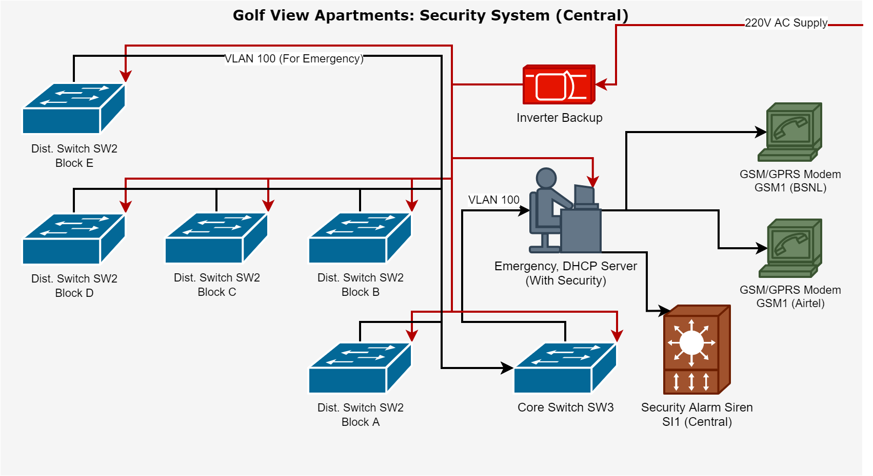

Slide 47
Network Implementation (TODO)
MikroTik CRS326-24G-2S+RM router: ₹18,000
Ubiquiti UF-SM-10G transciever: ₹4,000
TP-Link Jetstream T1600G-28TS switch: ₹1,90,000
TP-Link 10GBase-LR SFP+ LC Transceiver: ₹20,000
TP-Link TL-SG108E switch: ₹4,16,000
TP-Link TL-WA901N WiFi AP: ₹37,500
TP-Link TL-WR845N WiFi router: ₹6,54,500
2U Wall mount Cabinet Box: ₹1,10,500
12U Wall mount Network Rack: ₹48,000
Cat6 RJ45 Connector Plugs w/ Hood: ₹18,000
Cat6 Ethernet Cable (Roll): ₹1,50,000
RJ45 Cat6 Cable Jointer: ₹3,000
1.5m Cat6 Patch Cable: ₹1,35,000
M6 Cage Nuts, Washers & screws: ₹27,000
Mass Rack 10" Tray: ₹36,000
D-Link 24-port Cat6 Patch Panel: ₹2,70,000
RJ45/11 Crimper, Cutter & Stripper Tool: ₹3,000
River Fox Punch Down Tool Cat 5e/6: ₹1,500
Moelissa MS-LT02 RJ45/11 Cable tester: ₹1,500
Total Cost: ₹21,43,500

Slide 48
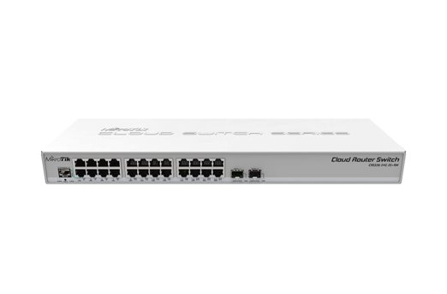
MikroTik CRS326-24G-2S+RM Cloud Router Switch
RS1
This is the router for devices (cameras, WiFi access points) common network. It does the job of a DHCP server, assigning private IP addresses to each common net device and translating any packets forwarded to the internet to public address (NAT/PAT).
Single mode optical fibre connection from ISP is terminated here (from ISP's central office). This is a separate connection taken by the Golf View Society and a common internet connection for internet access provided in Club House, Gardens, Playgrounds & Footpath.
24 x 1 Gb ethernet port
2 x 10 Gb SFP+ cages
Dual boot RouterOS / SwOS
1 as the central router.
Quantity: 1
Cost: ₹18000 x 1 = ₹18,000

Slide 49
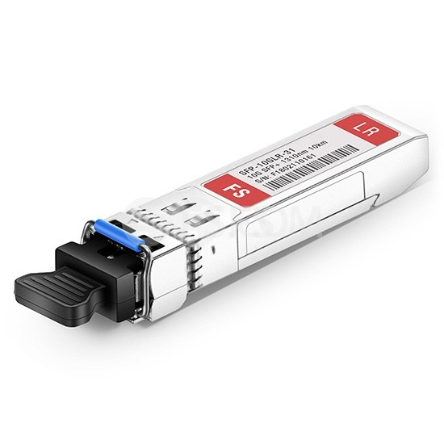
Ubiquiti UF-SM-10G 1310nm 10km SFP+ Transceiver
This Small Form-factor Pluggable (SFP) optical transceiver is to be inserted into the SFP+ cage of RS1, so that a 10Gpbs 1270/1330nm fiber line can be terminated at the router. The optical fiber must be a single-mode fiber upto 10km length. It accepts dual LC connector
This is the router for devices (cameras, WiFi access points) common network. It does the job of a DHCP server, assigning private IP addresses to each common net device and translating any packets forwarded to the internet to public address (NAT/PAT).
Single mode optical fibre connection from ISP is terminated here (from ISP's central office). This is a separate connection taken by the Golf View Society and a common internet connection for internet access provided in Club House, Gardens, Playgrounds & Footpath.
2 per block as central switch.
Quantity: 2 x 5 blocks = 10
Cost: ₹2000 x 2 = ₹4,000

Slide 50
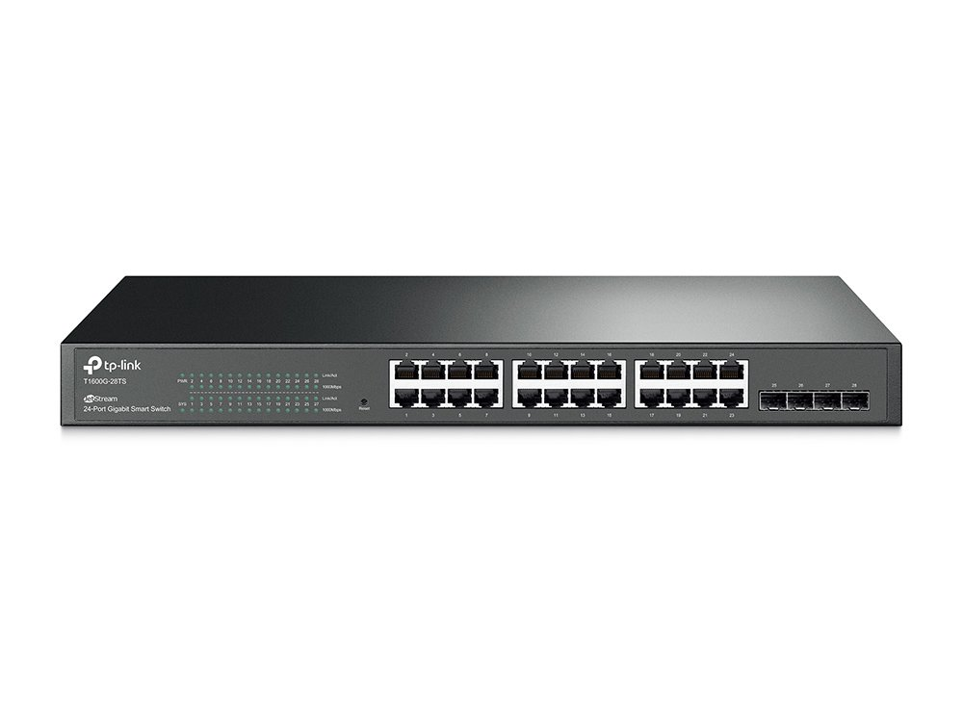
TP-Link Jetstream T1600G-28TS 24port Managed Switch
SW2
This is the central switch that is for both personal & common net.
In the personal net, each floor's router connect to this central switch. Single mode optical fibre connection from ISP is terminated here (from ISP's central office). This conection is kept different for each block. The ISP's DHCP assigns public IP to all home routers in each flat.
In the common net, switches from club, basement, footpath conect here. This is installed per block, so the access switches always connect to the nearest central switch. The central switches are the connect together from each block to the central router over Cat6 cable. As a whole they form a LAN behind the router.
24 x 1 Gb ethernet port
4 x SFP slots
2 per block as central switch.
Quantity: 2 x 5 blocks = 10
Cost: ₹19000 x 10 = ₹1,90,000

Slide 51
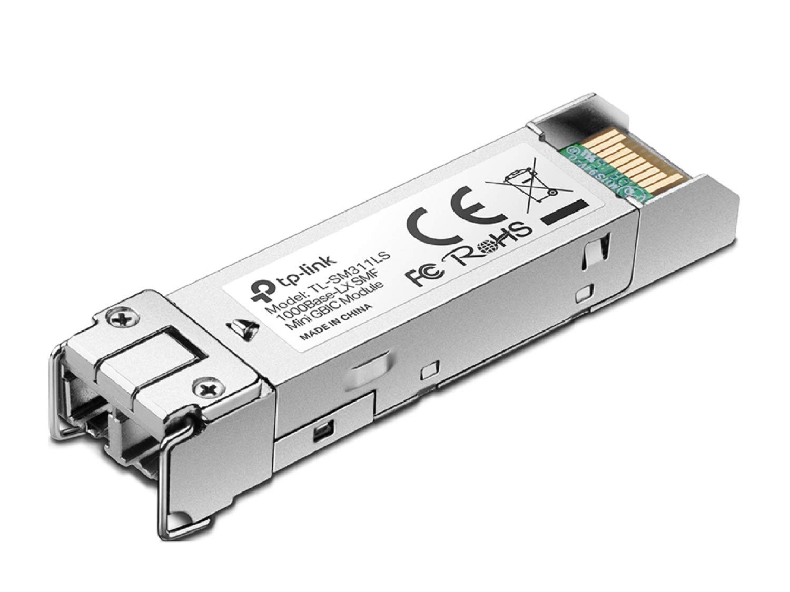
TP-Link 10GBase-LR SFP+ LC Transceiver
This is used with private net central switches to conect to ISP. The connection is individually made for each block.
Single mode optical fibre connection from ISP is terminated through (from ISP's central office) this transciever.
Wave Length 1310 nm
Fiber Type 9/125 μm Single-Mode
Max. Cable Length 10km
Data Rate 1.25 Gbps
Data Rate 10Gbps
Port Type LC/UPC
2 per central switch of personal net.
Quantity: 2 x 5 blocks = 10
Cost: ₹2000 x 10 = ₹20,000

Slide 52
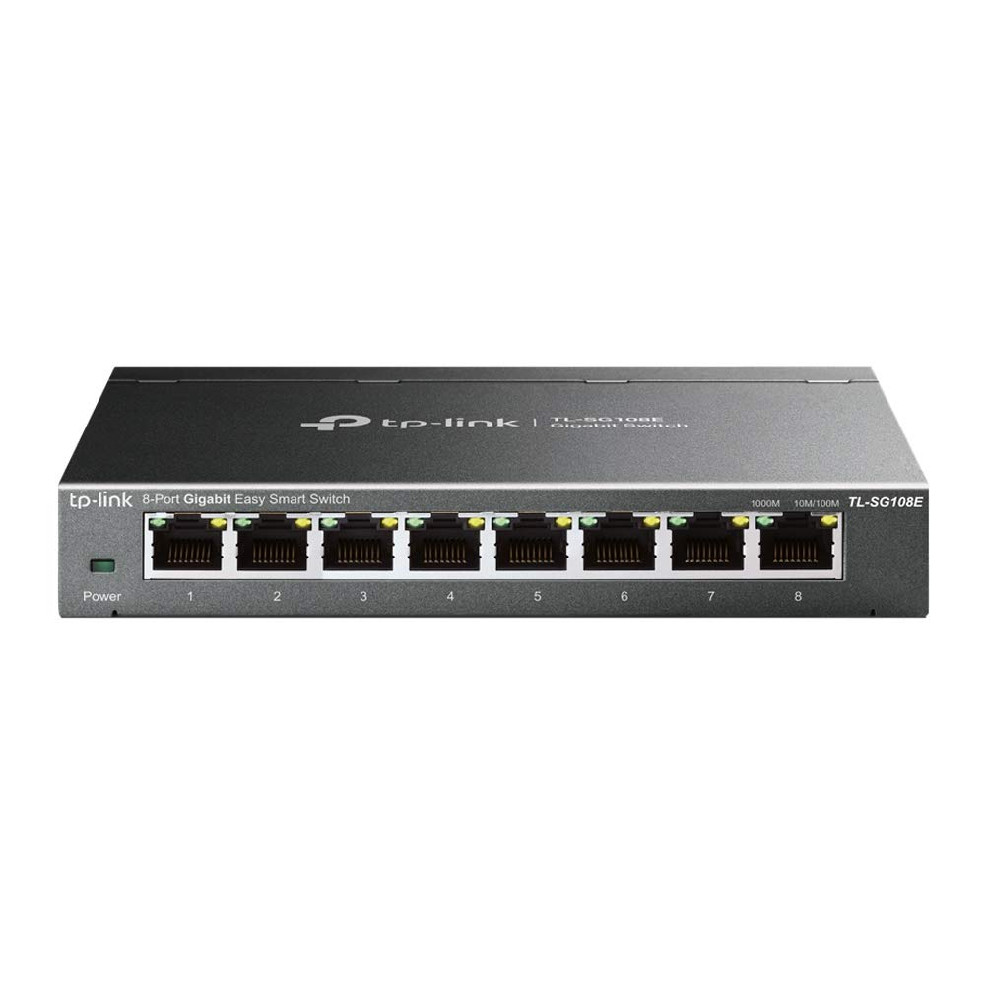
TP-Link TL-SG108E 8-port GbE Unmanaged Switch
SW1
This is an unmanaged switch that is used to make first level connections in both the personal and the common network. It then connects to the nearest central switch that is installed per block.
2 per floor (inc. club), 5 for basement, 5 for footpath, 1 for entry.
Quantity: 2 x 14 floors x 4 blocks + 2 x 15 floors + 2 club + 5 basement + 5 footpath + 1 entry + 2 spares = 160
Cost: ₹2600 x 160 = ₹4,16,000

Slide 53
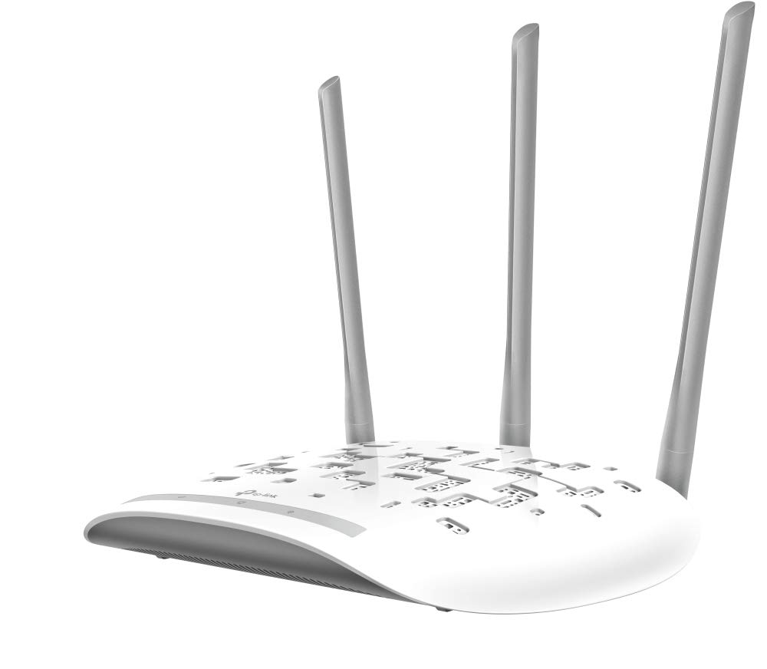
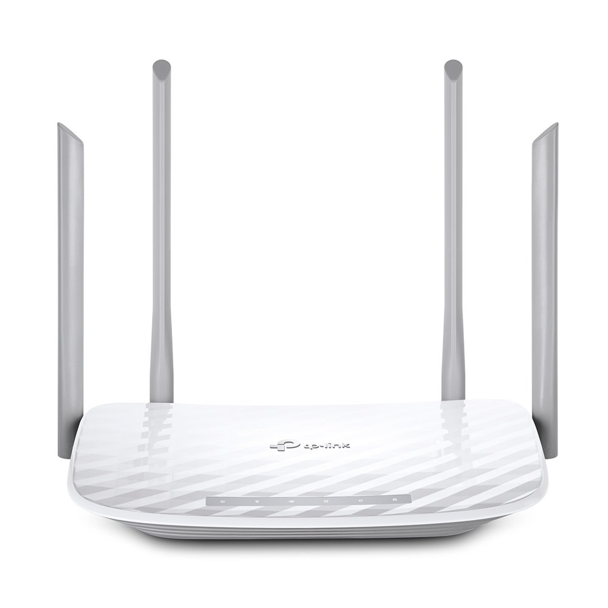
TP-Link TL-WA901N Wireless Access Point
TP-Link Archer A5 AC 1200 WiFi Dual Band Wireless Router
This a wireless access point without a router. It has the ability to extend WiFi. Used to provide internet connection in common areas.
1 in each room of club house + 15 across footpath
Quantity: 4 rooms x 2 floors (club) + 15 footpath + 2 spares = 25
Cost: ₹1500 x 25 = ₹37,500
This wireless router is provided to each flat. It is a dual band router to support more mobile devices.
1 for each flat
Quantity: 1 x 384 flats + 1 spare = 385
Cost: ₹1700 x 385 = ₹6,54,500

Slide 54
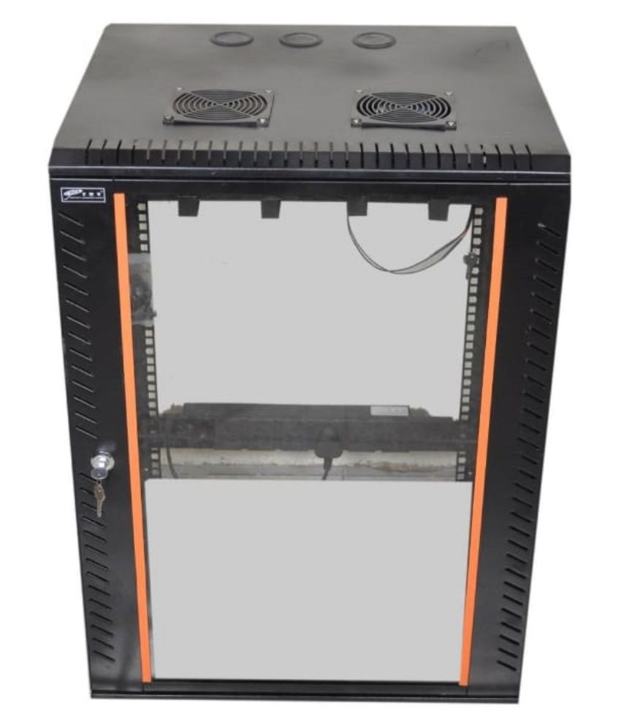
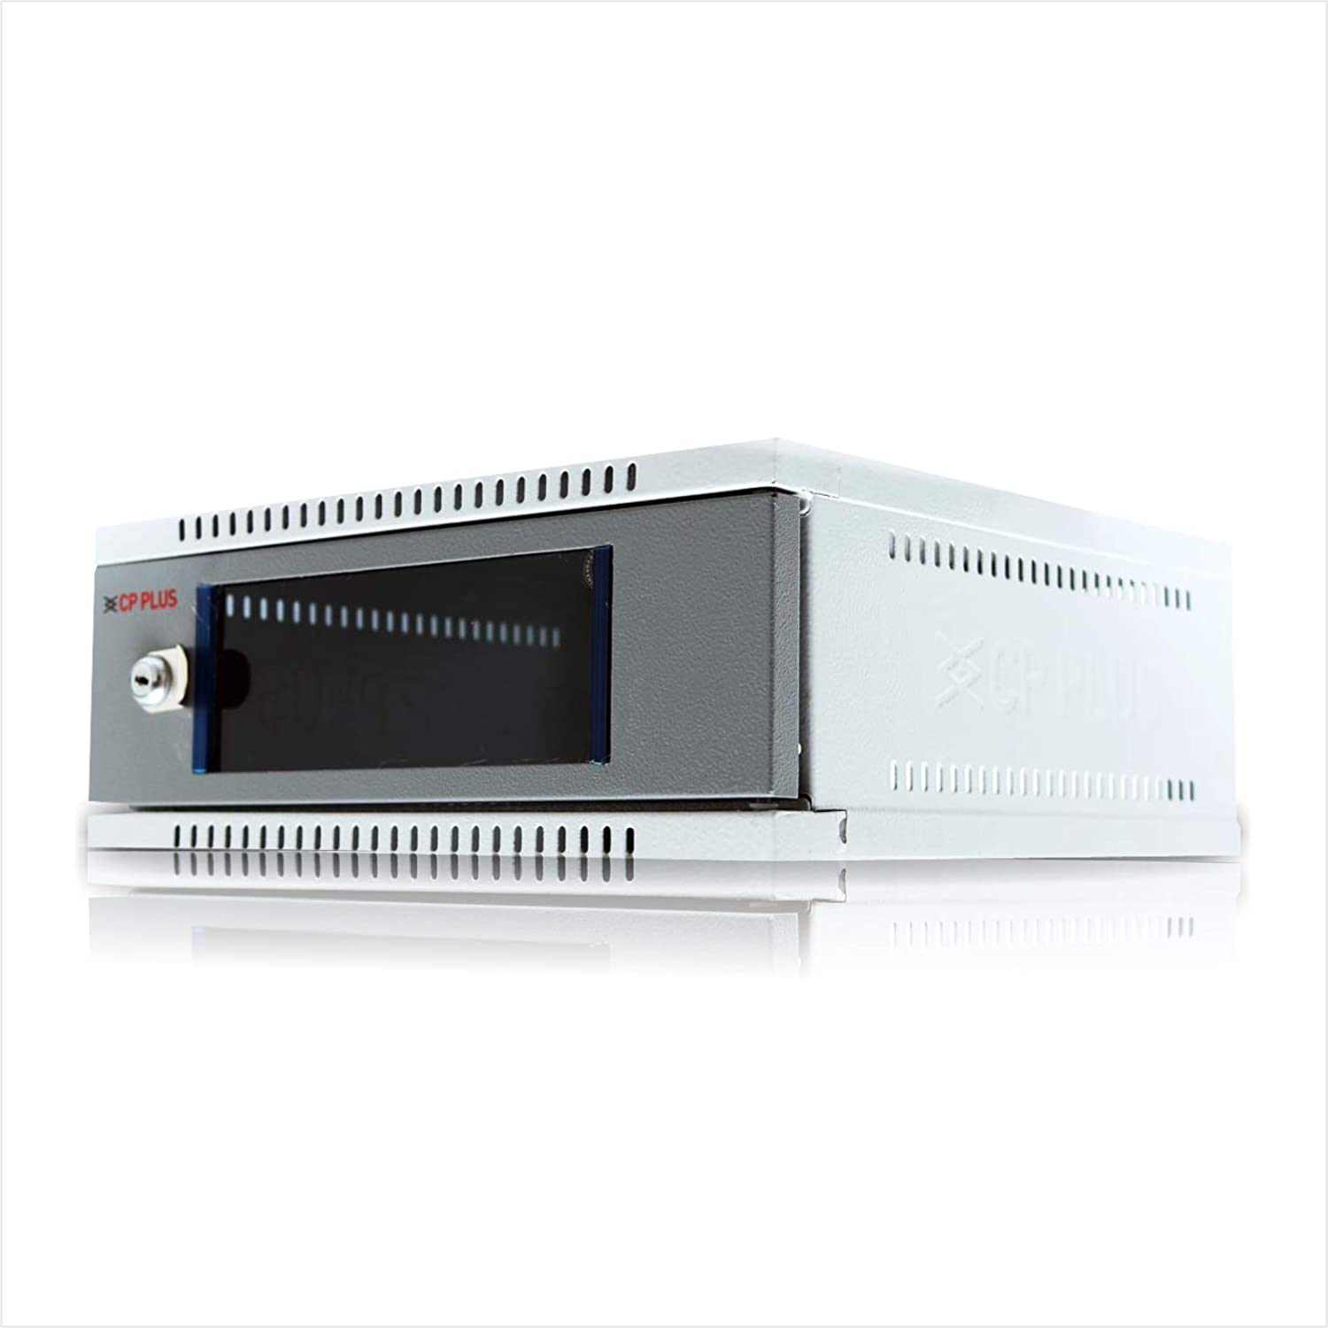
2U Wall mount Cabinet Box
12U Wall mount Network Rack
Holds the network devices onto the wall, for stable setup.
1 per floor + 2 for club + 1 for basement/block + 1 external/block + 1 entry/exit
Quantity: 1 x 14 floors x 4 blocks + 1 x 15 floors + 2 club + (1 + 1) x 5 blocks + 1 entry + 1 spare = 85
Cost: ₹1300 x 85 = ₹1,10,500
Holds the network devices onto the wall, for stable setup.
1 per block (for switches) + 1 for central router
Quantity: 1 x 5 blocks + 1 = 6
Cost: ₹8000 x 6 = ₹48,000

Slide 55
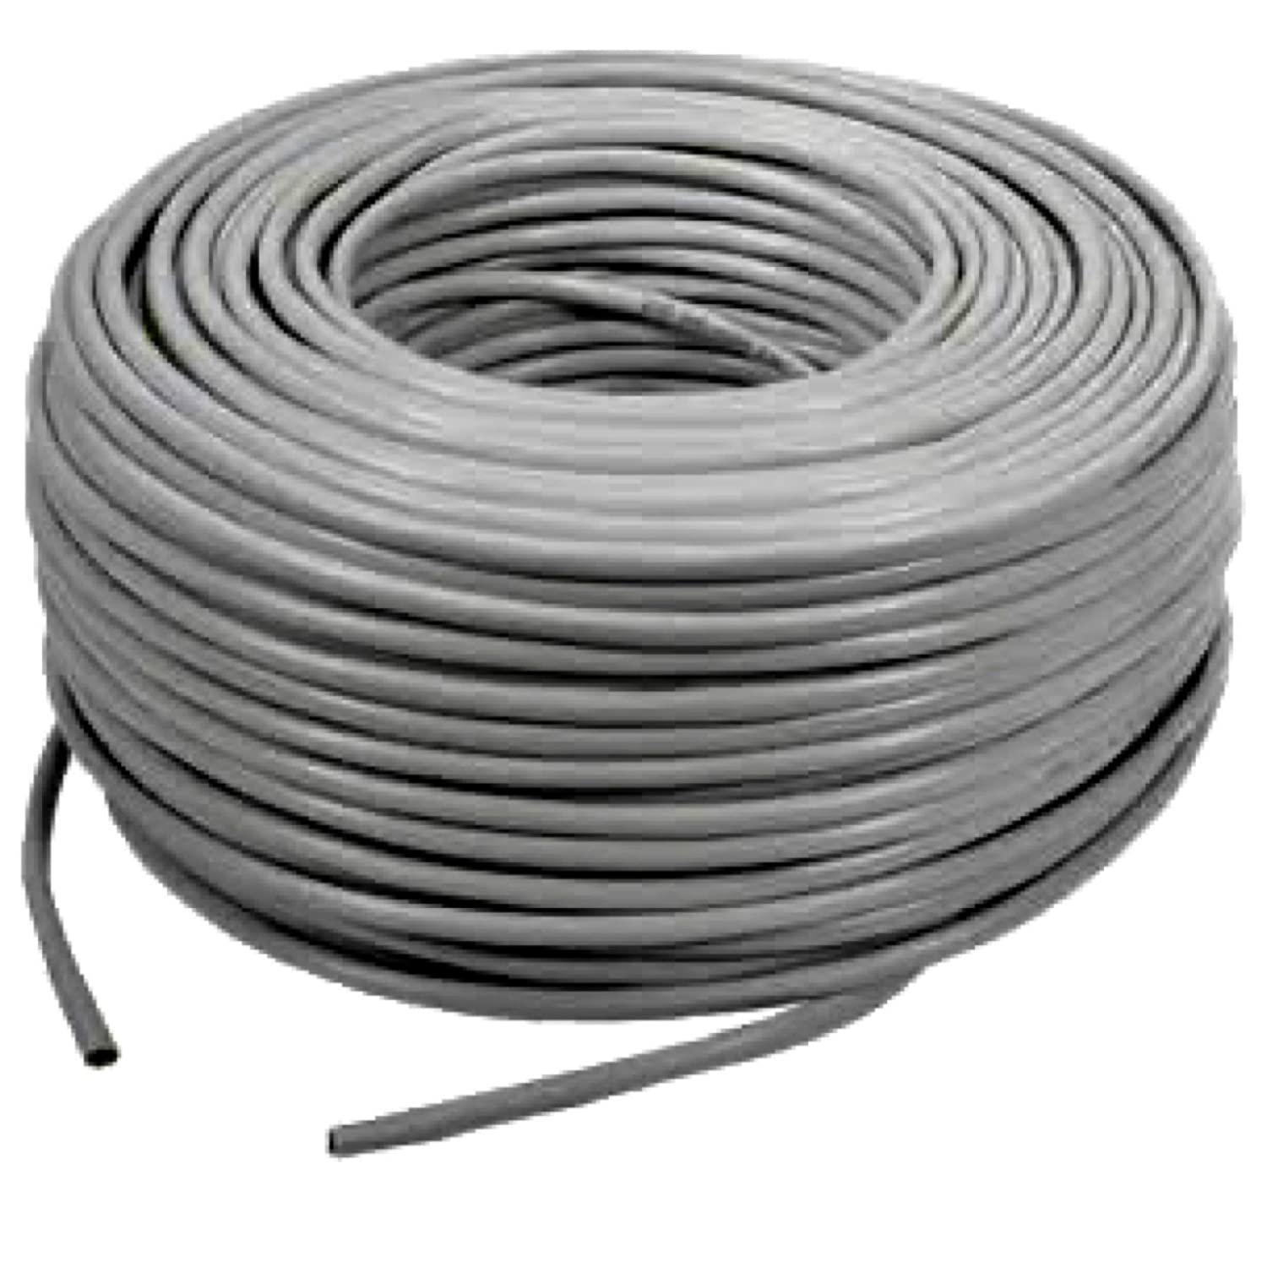
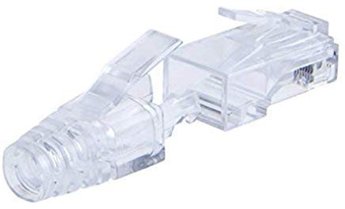
Cat6 RJ45 Connector Plugs w/ Hood
Cat6 Ethernet Cable (Roll)
This is the connector for Cat6 cable with staggered pins, which helps isolate signals at the port. It also minimizes distance from cable to reduce cross-talk.
2 per flat, 4 + 6 per floor (camera), 2 for external long connections, 2 for external short connections, 2 for block-block connections.
Quantity: 2 x 384 flats + 10 x 14 floors x 4 blocks + 10 x 15 floors + 2 x (15 basement + 15 footpath cam + 15 wireless AP) + 2 x 2 entry/exit + 2 x (3 + 3 + 3) + 2 + 2 x 4 blocks + 400 spare = 2000
Cost: ₹9 x 2000 = ₹18,000
Cat 6 cable supports 10Gbps utp 55m & 1Gbps upto 100m. Unlike Cat5e cable its wire pairs are twisted tighter, and it has a central plastic pair separator to maintain inter-pair distance as mentioned in the Cat6 specification. It is used for all cabling for uniformity sake.
Avg. 10m per flat, avg. 40m + 30m (camera) per floor, 20m for external long connections, 10m for external short connections (including club house), 60m for block-block connections.
Quantity: 10 x 384 flats + 70 x 2 x 14 floors x 4 blocks + 70 x 2 x 15 floors + 10 x (15 basement + 15 footpath cam + 15 wireless AP) + 10 x 2 entry/exit + 20 x (3 + 3 + 3) + 20 + 60 x 4 blocks + 310 spare = 15000
Cost: ₹10 x 15000 = ₹1,50,000

Slide 56
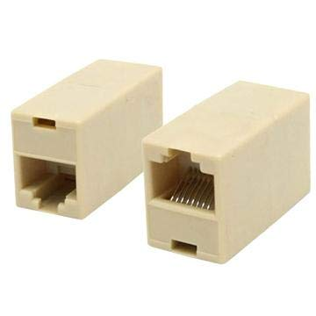
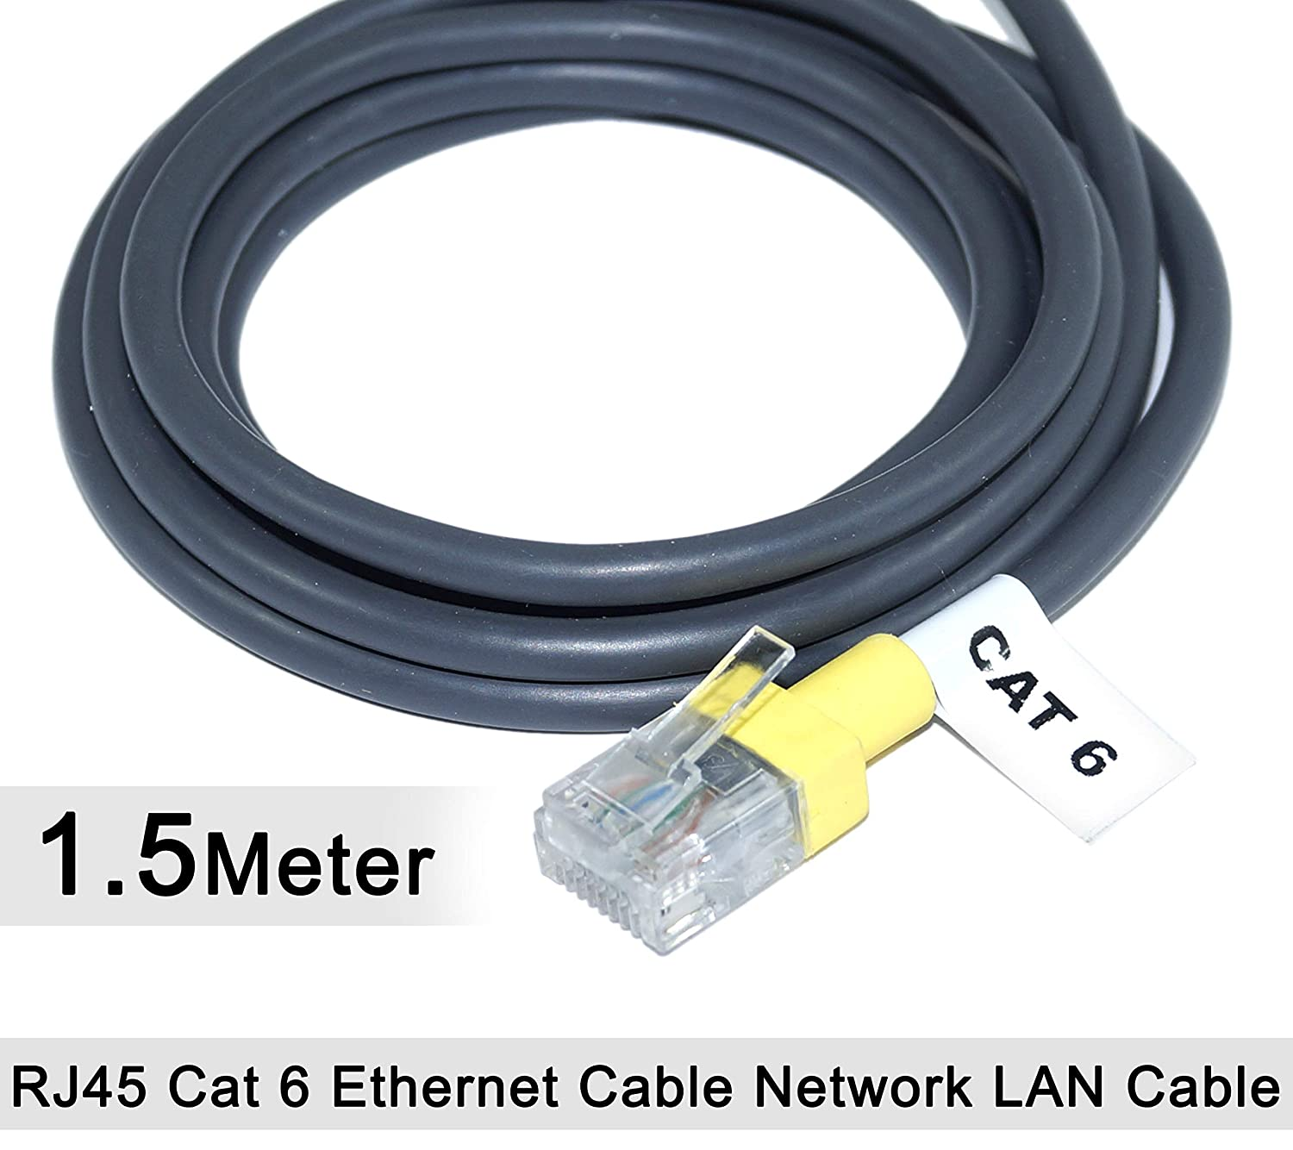
RJ45 Cat6 Cable Jointer (Couple Plug)
1.5m Cat6 Patch Cable
It is used to connect together 2 ethernet cables to form a longer cable. It also helps for maintaining some modularity.
2 per IP security camera & wireless AP.
Quantity: 2 x (15 basement + 15 footpath cam + 15 wireless AP) + 2 x 2 entry/exit cam + 6 spares = 100
Cost: ₹30 x 100 = ₹3,000
It makes it easy to make a connection between a port in a patch panel to a port on a network device. It is usually made of stranded copper wire for repeated use.
16 needed per floor (inc. club house). 48 needed per block, central room & a few spares.
Quantity: 16 x 14 floors x 4 blocks + 16 x 15 floors + 16 x 2 club + 48 x 5 blocks + 48 central + 44 spares = 1500
Cost: ₹90 x 1500 = ₹1,35,000

Slide 57


M6 Cage Nuts, Washers & Mounting screws for Server Rack & Cabinet
Mass Rack 10" Tray
It is used to mount network devices to racks.
16 needed per floor (inc. club house). 24 needed per block, central room & a few spares.
Quantity: 16 x 14 floors x 4 blocks + 16 x 15 floors + 16 x 2 club + 24 x 5 blocks + 24 central + 38 spares = 1350
Cost: ₹20 x 1350 = ₹27,000
Used to store additional length of cables below patch panel.
1 needed per floor (inc. club house). 2 needed per block, central room & a few spares.
Quantity: 1 x 14 floors x 4 blocks + 1 x 15 floors + 1 x 2 club + 2 x 5 blocks + 2 central + 5 spares = 90
Cost: ₹400 x 90 = ₹36,000

Slide 58


D-Link 24-port Cat6 Patch Panel
RJ45/11 Crimper, Cutter & Stripper Tool
It has ready to use RJ45 sockets on a panel that can be directly attacked to a network rack. This helps in cable management, and allows one to easily visualize, setup and debug network connections to switches / routers.
1 needed per floor (inc. club house). 2 needed per block, central room & a few spares.
Quantity: 1 x 14 floors x 4 blocks + 1 x 15 floors + 1 x 2 club + 2 x 5 blocks + 2 central + 5 spares = 90
Cost: ₹3000 x 90 = ₹2,70,000
This is a multitool that enables ethernet cables to be cut, insulation stripped, and the crimped onto a, RJ45 connector.
Would be useful when performing network setup to the flats, per floor cabinets as well as in network rack for server room. Preferable to have one spare per block.
Quantity: 5 blocks x 1 = 5
Cost: ₹600 x 5 = ₹3,000

Slide 59


River Fox Punch Down Tool Cat 5e/6
Moelissa MS-LT02 RJ45/11 Cable tester
It helps connect LAN cable to RJ45 socket (Keystone) in a Wall socket or a Patch panel. After stripping the outer cover of the Cat6 cable & plastic pair-separator, and plugging it into a Keystone, a neat connection can be made with this tool.
Would be useful when performing network setup to the flats, per floor cabinets as well as in network rack for server room. Preferable to have one spare per block.
Quantity: 5 blocks x 1 = 5
Cost: ₹300 x 5 = ₹1,500
It helps check if a cable if properly connected to a network device (like switch). The remote helps identify wire you have connected to, if there are too many tangled wires.
Would be useful for debugging connectivity issues when performing network setup / management. Perfereble to have one spare per block.
Quantity: 5 blocks x 1 = 5
Cost: ₹300 x 5 = ₹1,500

